Slide 1
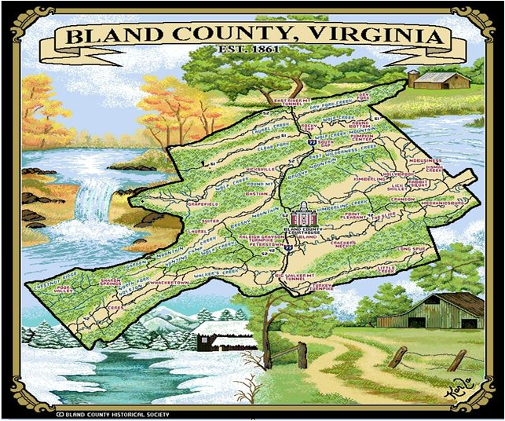
Bland County History is Anything but “bland”*
Ann Hardy Beardshall Presentation
Bland County Retired Teachers Association
October 19, 2023
Notes:
Title attributed to Denise Smith

Slide 2
Bland County History is Anything but “bland”*
Webster’s Definition of bland: (adjective)
lacking strong features or characteristics and therefore uninteresting
*title attributed to Denise Smith, Rocky Gap VA
(Afghan Print Designed by Pat Turner)
Notes:
Title attributed to Denise Smith

Slide 3
My Sense of Place: Bland County VA
“A Sense of Place.” was the theme of a conference that I attended at USM in the 1970s. At the conference it was pointed out that most Americans feel an affinity to a specific area of the United States. The conference was about the uniqueness that Mississippians feel about their State.
Topophilia is the sociologist’s term for the development of one’s sense of place.. The topics covered a myriad of subjects, such as “family ties, landscape features (mountains, streams, plants and trees), types of food, architectural styles, and a host of other cultural and environmental traits that help people to identify with a specific geographical place.”
I am currently working on our family history and memories using the sense of place theme as the framework for our trilogy entitled “Places Called Home.”
Part I of the Trilogy will describe the places our ancestors, great grandparents, grandparents, and parents called home. We will define the direct role our ancestors played in determining the place of our birth. The first part will conclude with the places thought of as our hometowns in Bland, Virginia. Part II will include my early life in Bland. My beginnings were in the small town of Bland, Virginia in the Allegheny chain of the Appalachian Mountains where I lived for the first 18 years of my life.
Part III will be about the places our children called home.

Slide 4
History of Bland County: 1861 – 2022*
  Pre-1861: Native American Inhabitants Before European settlement, the area that would become Bland County was inhabited by various Native American tribes, including the Cherokee and Shawnee.
  European Settlement and Formation of Bland County European settlers began to arrive in the late 18th century. Bland County was formed from parts of Wythe, Tazewell, and Giles counties on March 30, 1861, just a few weeks before the outbreak of the American Civil War.
  Civil War (1861-1865) During the Civil War, Bland County, like much of Virginia, was deeply affected by the conflict. It was the site of several skirmishes and military activities due to its strategic location and transportation routes. After the war, the county faced challenges in rebuilding its economy and infrastructure.
  Late 19th to Early 20th Century In the late 19th and early 20th centuries, Bland County's economy relied heavily on agriculture, particularly tobacco farming. The arrival of the Norfolk and Western Railway in the late 1800s facilitated transportation and trade in the region, helping the local economy grow.
  20th Century and Beyond Throughout the 20th century, Bland County experienced changes in its economic base, shifting away from agriculture and towards other industries such as mining and manufacturing. The discovery of mineral deposits, such as coal, led to increased mining activities in the region. However, like many rural areas, Bland County faced economic challenges and population decline during the latter half of the 20th century.
  Modern Times (Post-2000) In the 21st century, Bland County continued to grapple with economic and demographic issues. Efforts were made to diversify the economy and attract new businesses, but it remained a predominantly rural and sparsely populated area.
  *ChatGPT: https://chat.openai.com/

Slide 5
The First People in Bland County
Pre-1861 - Native Americans in Bland County aka Eastern Woodland Indians
Before European settlement, the area that would become Bland County was inhabited by various Native American tribes, including the Cherokee and Shawnee.

Slide 6
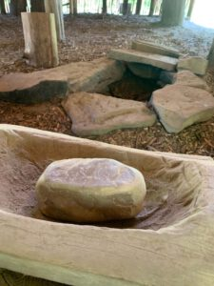
Pre-1861: Native American Inhabitants
Wolf Creek Indian Village and Museum, based on the Brown-Johnston Archelogy Site discovered in 1970, gives a glimpse into the life of the Eastern Woodland Indians.
Indians who came to Bland County were here only temporarily for hunting and warring. Not much, if any, permanent settlement of Native American tribes.
Hunting and fighting area for the Cherokees (to the South) and the Shawnees (to the North). These tribes disliked each other.
Proclamation of 1763 (after French/Indian War) caused Virginia to pass laws that no settlements by European settlers could be made west of the Blue Ridge Mountains. This was done to appease Indians and stop land speculators.
Few settlers came because Indian Massacres stopped many.
Flood gates opened when land grants were given to Revolutionary War Soldiers after the Revolution (about 1790) .
Artifacts from Archelogy Dig
In 1970 at Wolf Creek Indian
Village. https://indianvillage.org/

Slide 7
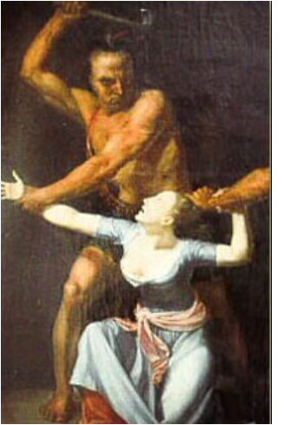
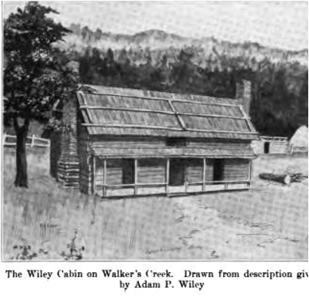
Pre-1861: Indian Raids and Massacres in Bland County
1774: Sluss Massacre near Ceres by Shawnees
1789: Jenny Wiley taken captive on Walker’s Creek (Bland County) by Shawnees
1790: Davidson (Andrew) Family taken captive by Shawnees in Rocky Gap
1794 - the Last Indian Raid in SWVA was April 5, 1794 in Scott County

Slide 8
The First White Settlers in
Area to Become BLAND COUNTY
(1790 – 1861)
European Settlement and Formation of Bland County European settlers began to arrive in the late 18th century.

Slide 9
Where the First Settlers Came From
(late 18th or early 19th Century)
Migration had a familiar ring:
Many came from Germanic Regions of Europe about 1750 to Pennsylvania, stayed there until the close of the Revolutionary War, then migrated to SWVA
English speaking entered eastern ports from Europe and England
Germans primarily settled in Wythe County, then crossed the mountain into future Bland County or Tazewell County
English and Scots-Irish came from Tidewater VA and settled in the Walkers Creek Valley portion and a few in the Wolf Creek Valley of future Bland County
Many had land grants from service in Revolutionary War or War of 1812

Slide 10
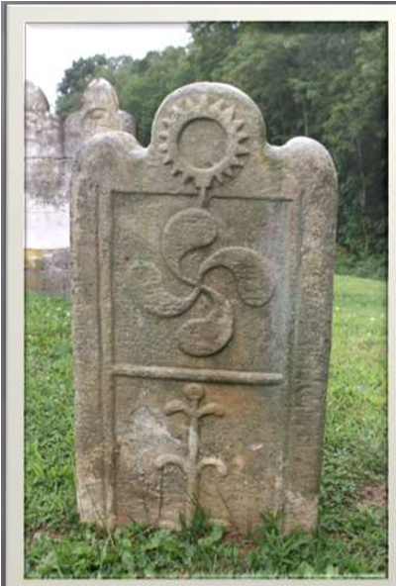
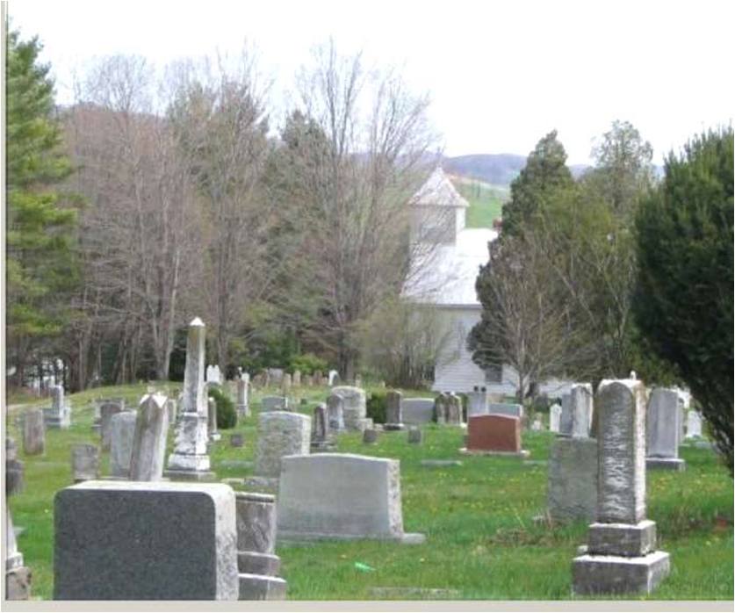
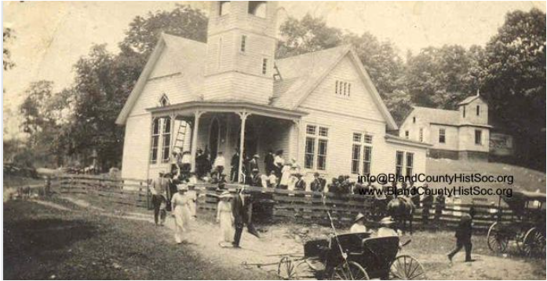
Pioneers Brought Their
Religion and Churches with Them
First Churches Before Bland County Formed
1812: Rev Samuel Newberry, Joshua Bruce, John Grayson Cecil and Zachariah Mitchell were licensed to preach at the same time and place – July 4, 1812 at Nicewander Meeting House near Crandon - no longer exists
1817 – Sharon Lutheran Church brought current property, Presbyterians joined them in 1827 them and became Sharon Union Church. Methodists also joined them for a while. 1911- Sharon Presbyterians sold their interest in the Union Church and built the Sharon Presbyterian Church. Sharon Lutheran Church is the oldest continuously operating church in Bland County. The Church and Cemetery in Bland County that are one of 4 places on the National Historic Registry.
1843 – David Byrnes deeded property where Byrnes Chapel UMC is located to the Mechanicsburg Meeting House
1793 – First Circuit Rider of the Methodist Church came to area proliferation of Methodist Churches (Asbury, Sheffey, circuit riders). Little Creek Road has a Methodist Church every 7 miles so parishioners could walk or ride easily to the Church.
Sharon Lutheran
Byrnes Chapel

Slide 11
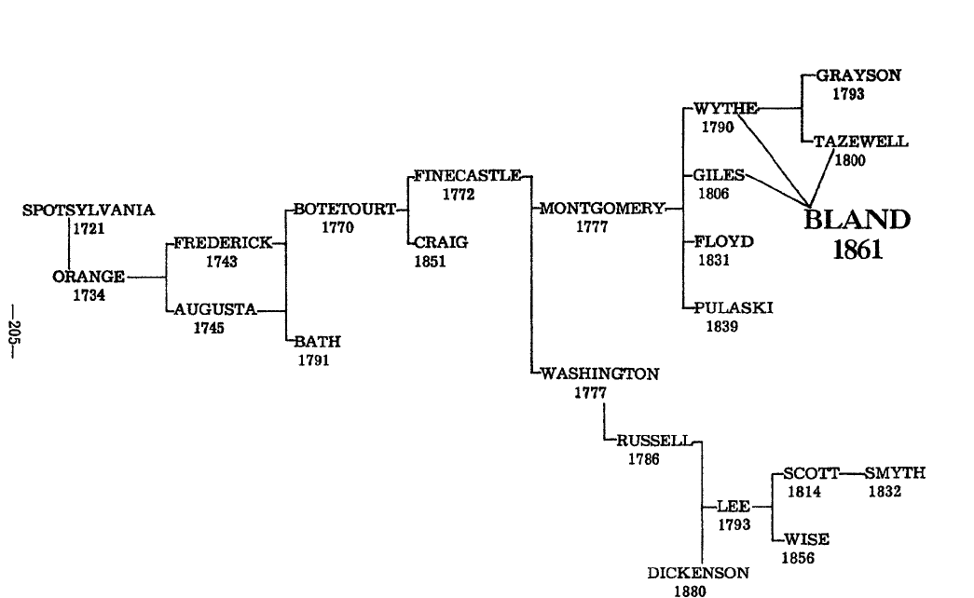
Where the First Settlers Were Governed Before We had a County of Bland County
Year | County | Courthouse
1721–1745 | Spotsylvania | Spotsylvania (near Fredericksburg)
1745-1770 | Augusta | Staunton (extended to Pacific Ocean)
1770-1772 | Botetourt | Formerly Augusta – (1770 - 1772)
1772-1777 | Fincastle | Discontinued (records in Montgomery)
1777-1790 | Montgomery | Christiansburg (records from 1773)
1790-1861 | Wythe | Wytheville (part that became Bland)
1800-1861 | Tazewell | Tazewell (part that became Bland)
1806-1861 | Giles | Pearisburg (part that became Bland)
Notes:
When doing genealogical research, important to know the county in which your ancestor resided. Map is that Virginia Map in 1860 (contains all the counties of WV. Bland County formed just one year later.

Slide 12
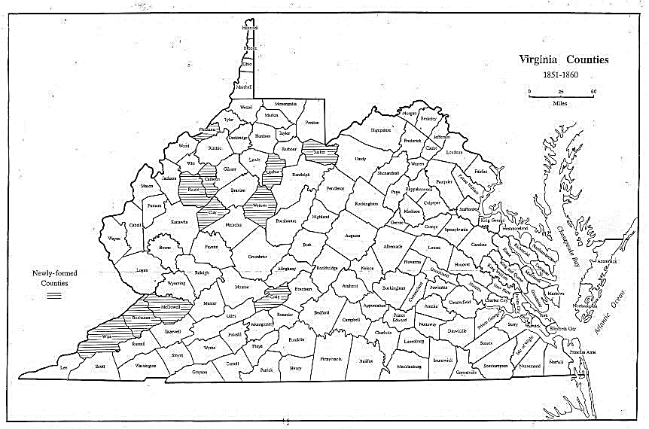
Counties of Virginia
Just Before of Bland County Was Formed
Map of Virginia in 1860
Virginia County Formation in 1860
Notes:
When doing genealogical research, important to know the county in which your ancestor resided. Map is that Virginia Map in 1860 (contains all the counties of WV. Bland County formed just one year later.

Slide 13
So why did we need a County??
Took 3 days to go to the nearest Courthouse
  2 days of travel
  1 to transact business
Resentment for paying taxes for benefits outside of the local area.
Primitive Roads
Walkers Creek Holston Turnpike (east to west)
Raleigh Grayson Turnpike (south to north)
Intersection was at Crab Orchard (now known as Bland)

Slide 14
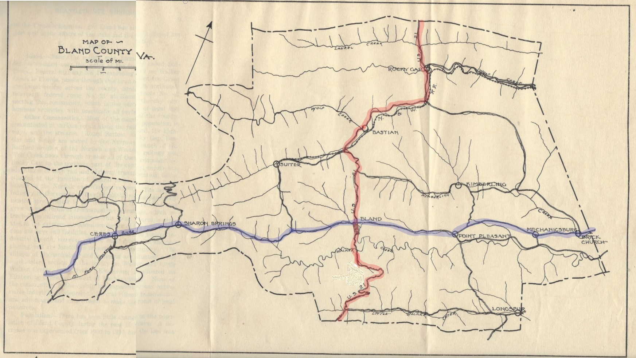
Primitive Roads at the time of Formation
Red Route=Raleigh/ Grayson Turnpike
(route: Raleigh County WV (Beckley) to Grayson County VA (Independence)
Blue Route =Walkers Creek (Giles County) /Holston Turnpike (Smyth County)
These roads were very narrow, unpaved, foot or horsepaths, barely room for a wagon or carriage.

Slide 15
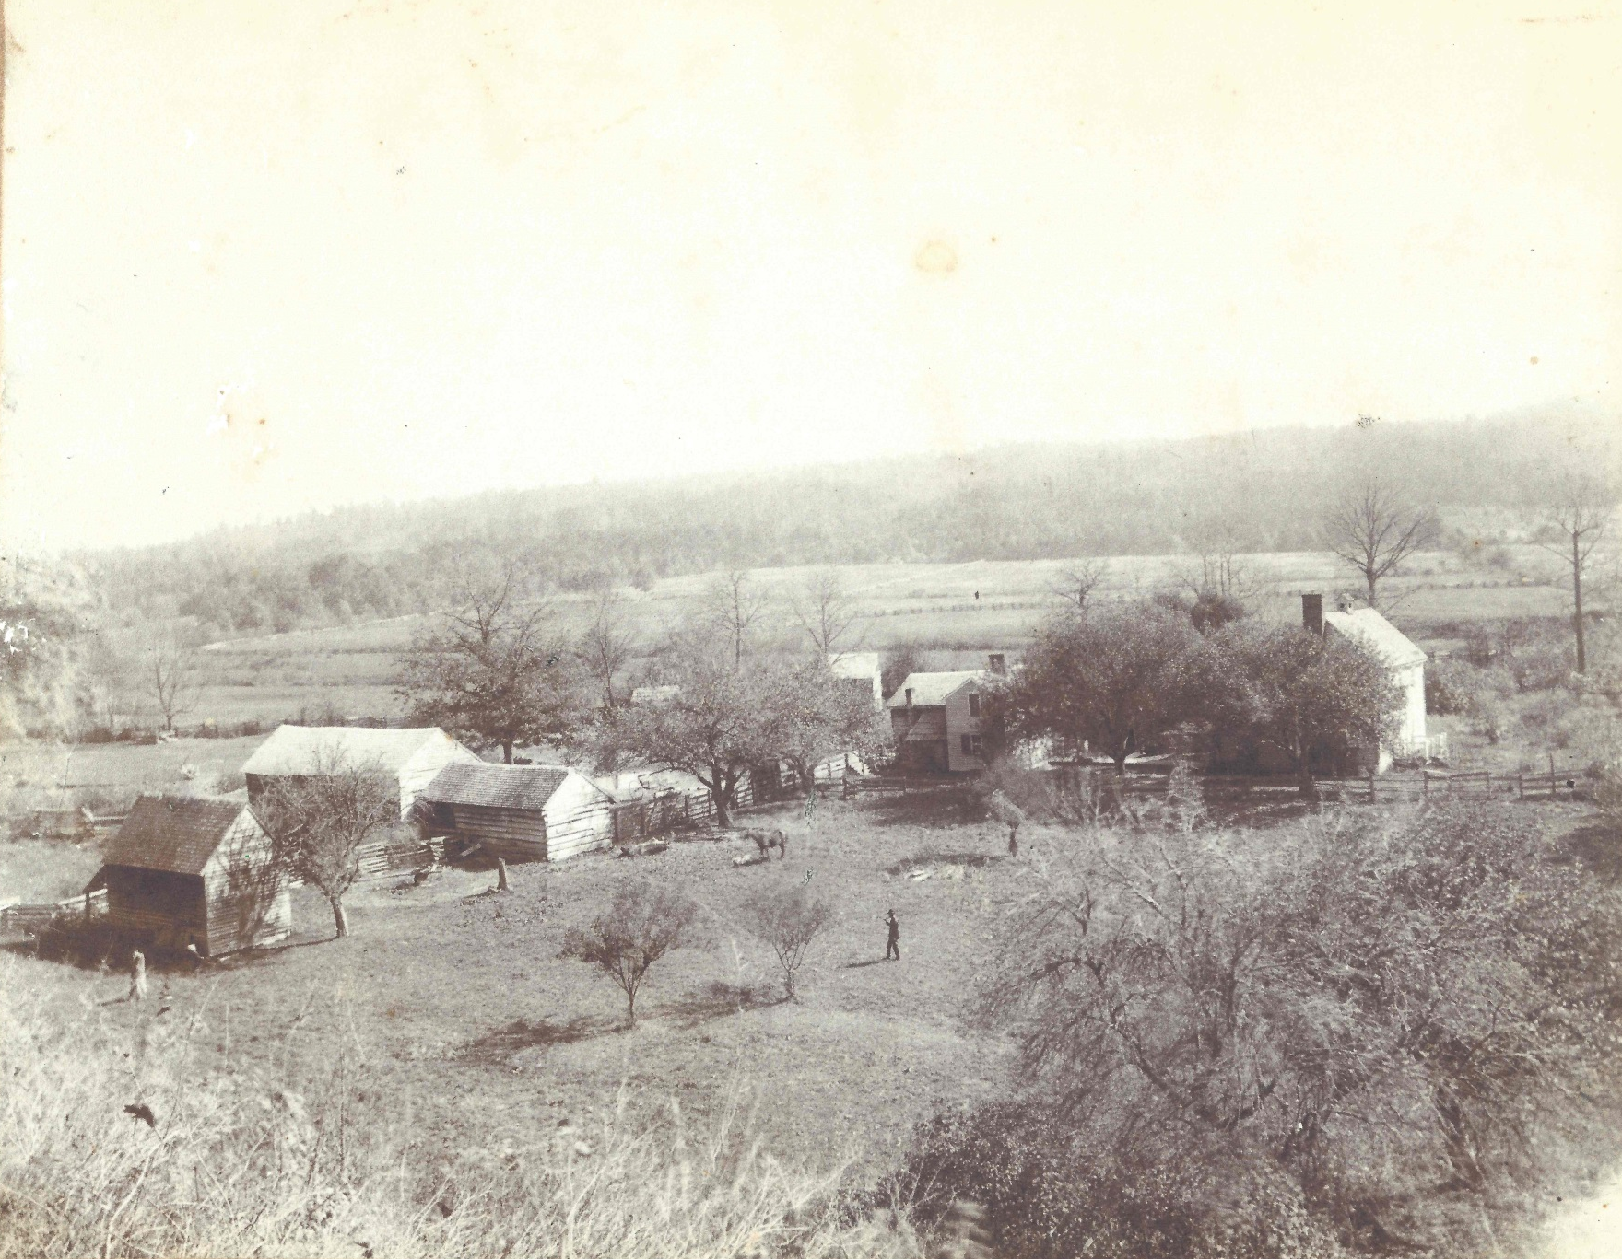
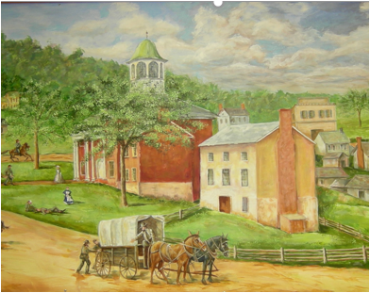
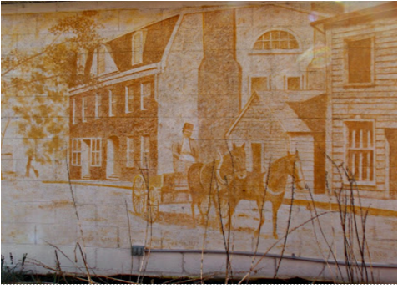
One Man’s Difficult Travel To Conduct County Business
NoBusiness to Pearisburg
August Wesendonck
The push to create Bland County resulted from popular dissatisfaction with the distances required to travel to the various county seats in the area. The distances and the difficult mountain trails created a significant hardship for those needing to conduct legal affairs. August Wesendonck lived in NoBusiness, Giles County, approximately 25 Miles from county courthouse in Pearisburg. The trip required an overnight stay at the Western Hotel in Pearisburg. After Bland County was formed, he only needed to travel 10 miles to Bland Court House.
Cluxi, home of August Wesendonck
Nobusiness, Bland County, VA
      Giles County, Virginia Courthouse (circa 1865)
      (Painting by Kate Delaney
Western Hotel in Pearisburg, VA (circa 1850)
(Mural by Jane Bode)

Slide 16
The First Efforts to Form Bland County 1850-1860
Efforts began as early as 1850
Successful Petitions from 3 counties (Giles, Tazewell, Wythe) were submitted to the General Assembly on December 5, 1859.
However,
  Two areas presented petitions to be excluded: southern edge, e. g. Little Creek area (closer to Wythe County Courthouse) and northwestern area, e. g., Laurel Fork area (closer to Tazewell Courthouse).
  Petition from objecting residents of Tazewell County voted against petition in 1860. Majority voted NOT to be included, but the act included them anyway.
Notes:
Reason for forming a county: difficulty traveling to county courthouse to conduct business and outlying areas were not benefiting from taxes. Efforts started early in the 1850s.

Slide 17
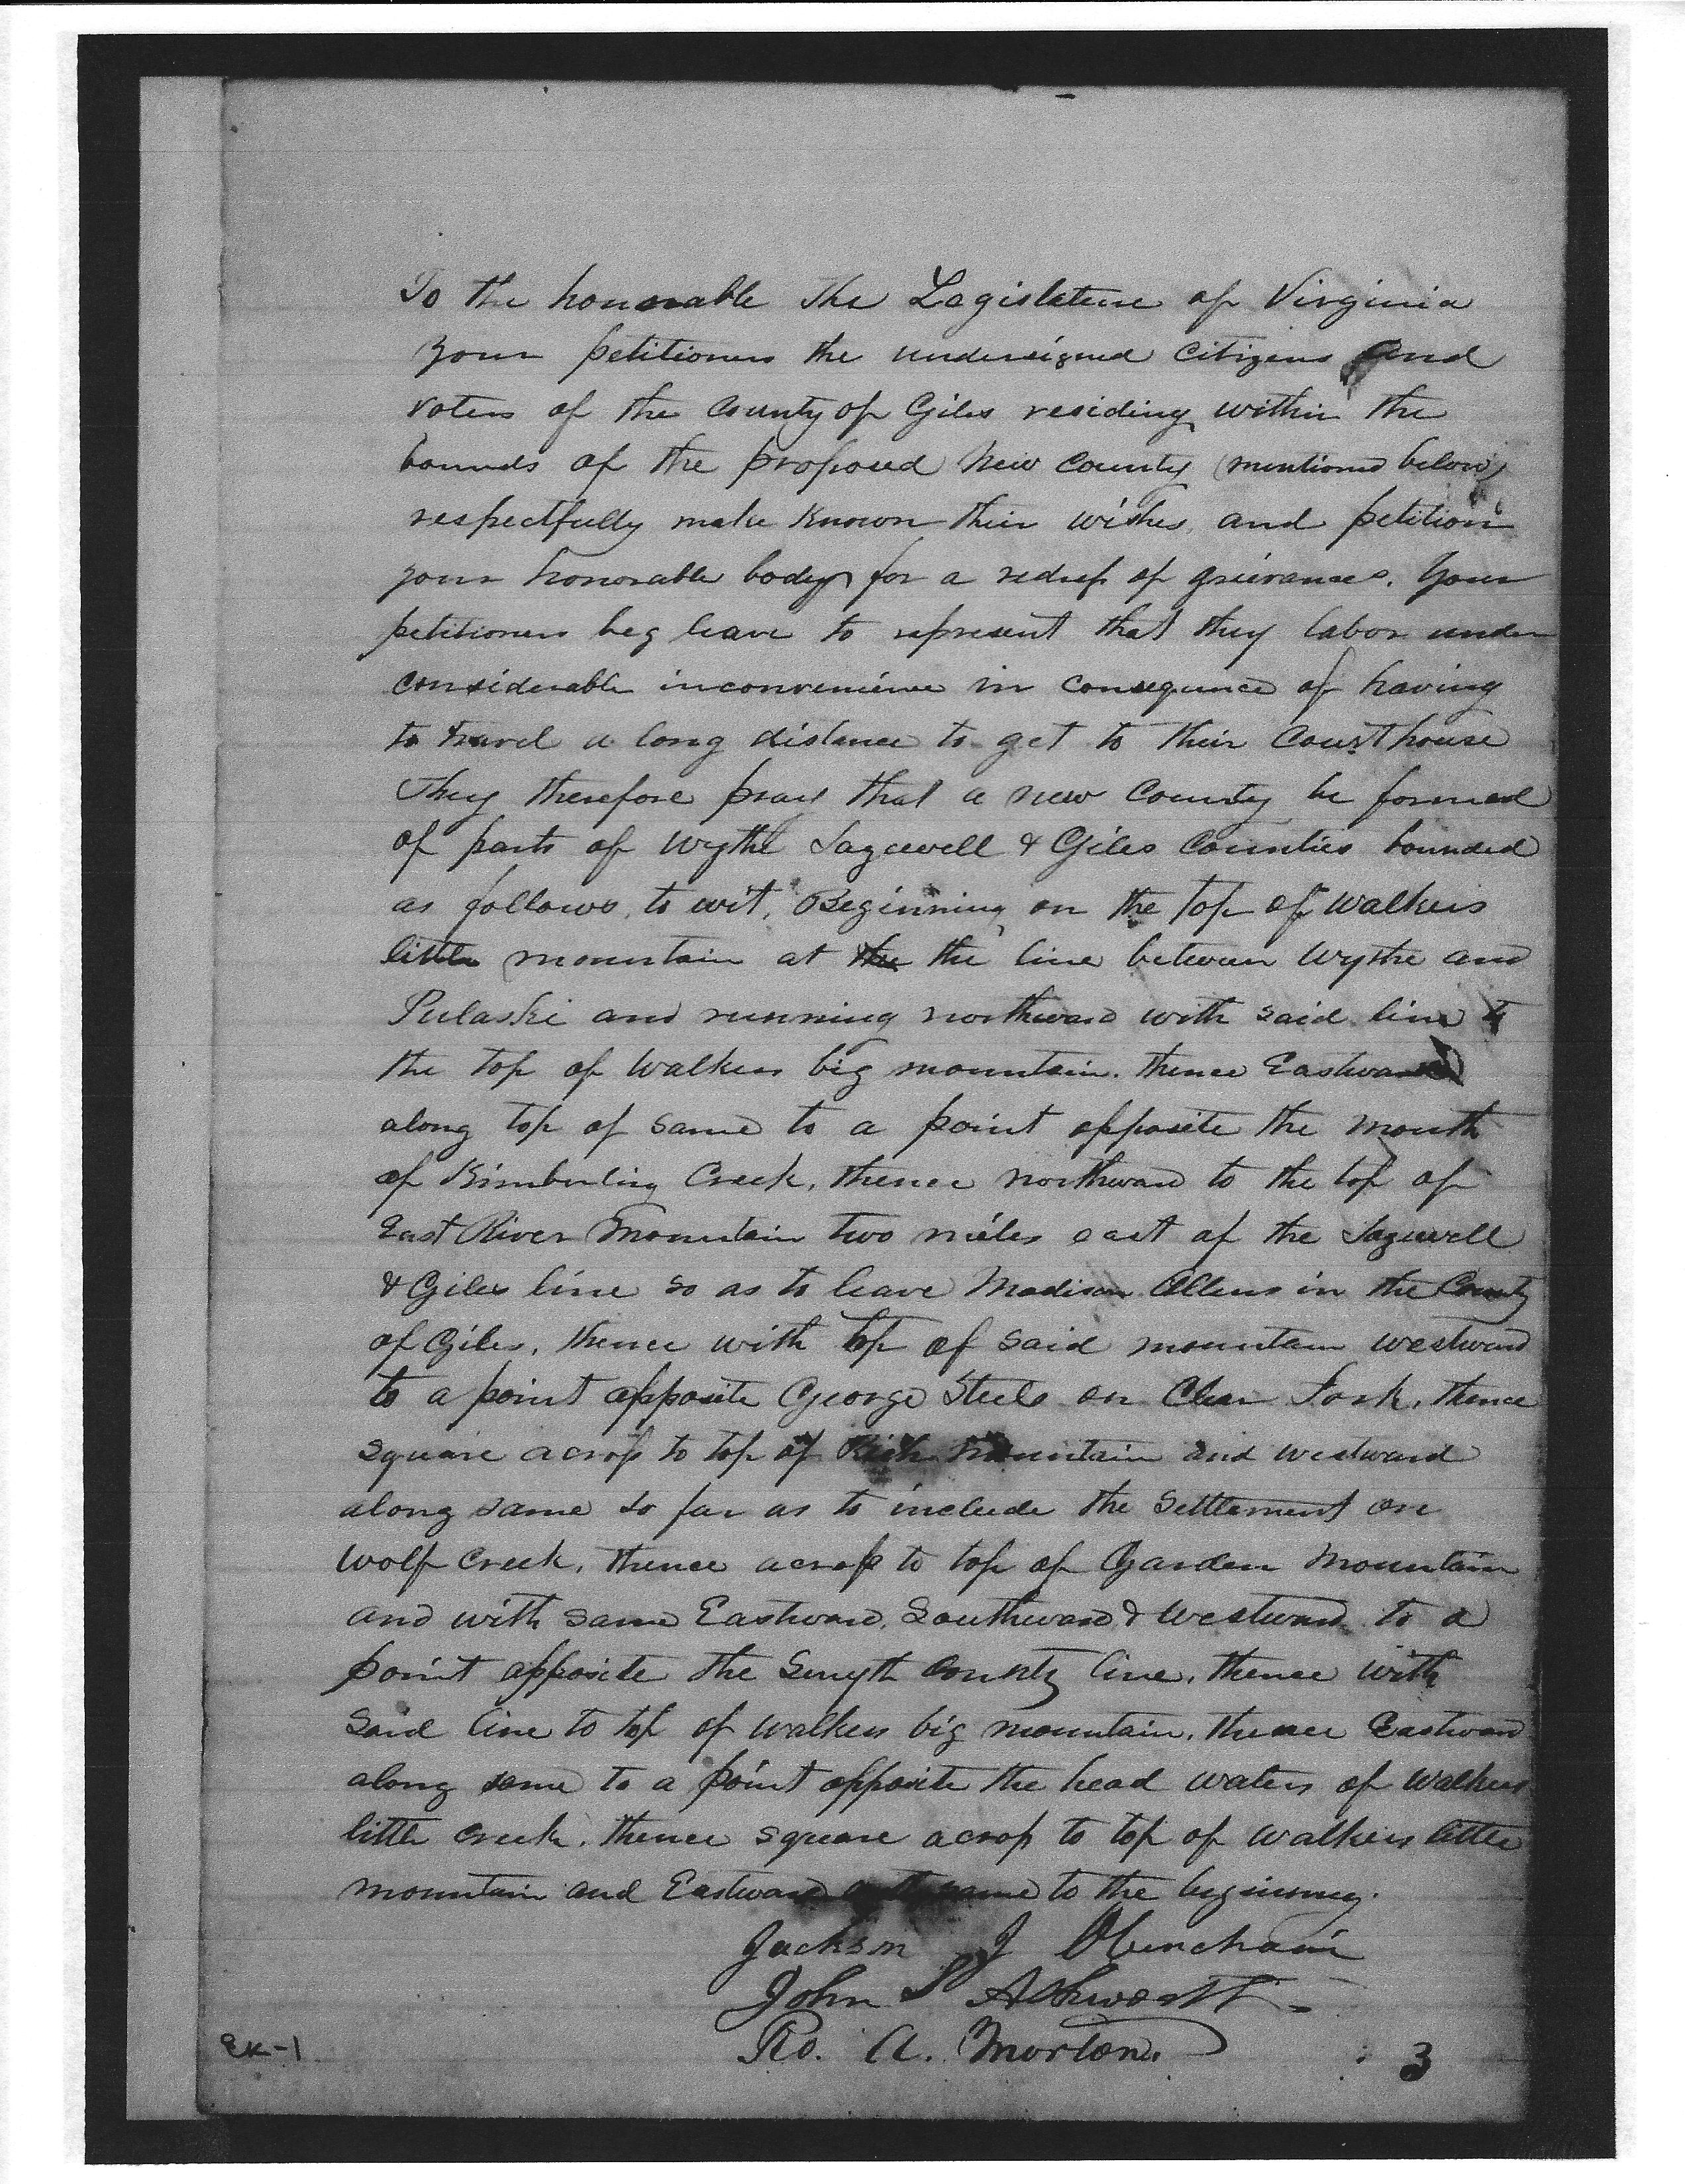
3 Petitions to Form Bland County
Submitted to the VA General Assembly
December 5 1859
TEXT OF THE PETITION FROM 3 COUNTIES TO FORM BLAND COUNTY
To the honorable Legislature of Virginia your petitioners the undersigned citizens and voters of the county of (Giles, Tazewell, Wythe) residing within the bounds of the proposed new county (mentioned below) respectfully make known their wishes and petitions to your honorable body for a redress of grievances. Your petitioners beg leave to represent that they labor under considerable inconvenience in consequence of having to travel long distance to get to their courthouse. They therefore pray that a new county be formed of parts of Wythe, Tazewell and Giles Counties bounded as follows, to wit: Beginning on the top of Walkers Little Mountain at the line between Wythe and Pulaski and running northward with said line to the top of Walkers Big Mountain thence Eastward along top of same to a point opposite the mouth of Kimberling Creek, thence northward to the top of East River Mountain two miles east of the Tazewell and Giles line so as to leave Madison Allen's in the County of Giles, thence with top of said mountain westward to a point opposite George Steele on Clear Fork, thence square across to the top of Rich Mountain and westward along same so far as to include the settlement on Wolf Creek, thence across to the top of Garden Mountain with same Eastward, Southward & Westward to a point opposite the Smyth County line. Thence with said line to top of Walkers Big Mountain, thence Eastward along same to a point opposite the head waters of Walkers Little Mountain and eastward with same to the beginning.
Signed: Jackson Obenchain (and 31 other signatures of citizens from the Giles County area)
Signed: E. S. Lambert (and 62 other signatures of citizens from the Tazewell County Area)
Signed: Hiram Robinett (and 82 other signatures of citizens from the Wythe County area)
Facsimile of the Petition from Giles County

Slide 18
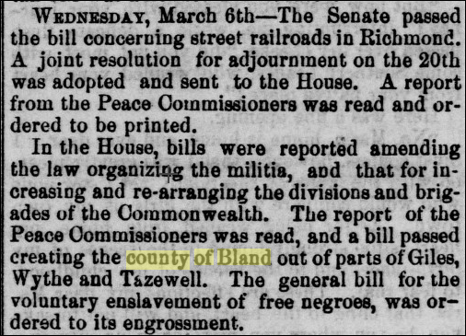
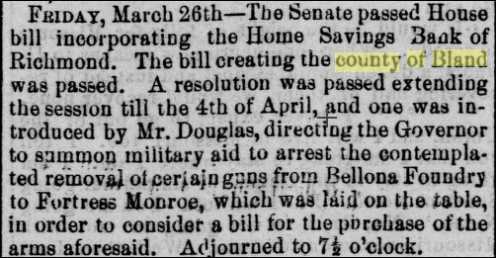
Act of General Assembly – 03/30/1861
Bland County was officially formed on March 30, 1861, from parts of Wythe, Tazewell, and Giles counties. Additional land from Giles County was added later. The county was named after Richard Bland, a Virginia statesman and political figure who helped lead the struggle for freedom and independence from England. Below are articles that appeared in the Staunton Spectator in 1861.
Passed: House on March 6, 1861 Passed: Senate on March 26, 1861

Slide 19
Act to Form Bland County by Act of VA General Assembly on 03/30/1861
Senator James Seddon worked out the guidelines for the new county (20 sections) were delineated in the bill passed by the Virginia House on March 6, 1861 and by the Virginia Senate on March 26, 1861. The legislation was signed by the Governor John Letcher, who served from 1860 until 1864. The act became effective on March 30, 1861. Chapter 23 of the Summary of the General Assembly of 1861 summarized the act to form Bland.
Bland County possessed one of the original handwritten copies of “Act to Establish the county of Bland out of parts of Giles, Wythe and Tazewell, Passed March 30, 1861.” In the Bland Courthouse fire of 1888 this original copy was destroyed. However, the Library of Virginia also has an original copy in its archives and it is the intent of the Bland County Historical Society to acquire an electronic copy of this document. The full Act was re-published by an early Bland County Newspaper, named The South-West on Thursday, January 5th, 1893. The editors, W. C. Hedrick and Fulton Kegley, had obtained a pamphlet from W. W. Grayson with the full version of the Act. This newspaper article owned by the Bland County Historical Society served as the basis for printing the act in The History of Bland County, 1961.

Slide 20
Act of General Assembly – 03/30/1861
Guidelines for the new county were delineated in the bill passed by the Virginia House on March 6, 1861 and by the Virginia Senate on March 26, 1861. The legislation was signed by the Governor John Letcher, who served from 1860 until 1864. The act became effective on March 30, 1861. The complete reading of the Act to Form Bland County can be found in Appendix A. Chapter 23 of the Summary of the General Assembly of 1861 summarized the act to form Bland:
Section 1: County boundaries were defined and the name of the county known as Bland.
Section 2: James W. English of Giles County, Samuel Cecil of Tazewell County and Richard Gibboney of Wythe County were appointed commissioners to select site for courthouse, jail and other public buildings.
Section 3: The above commissioners were allowed $3.00 per diem for their services.
Section 4: John W. Tracy, Jesse Justice, Joseph Fanning, John Mustard, Thomas Shannon, George Robinett and Isaac Kegley were appointed commissioners to receive the report of site selection for public buildings from the commissioners named in Section 2.
Section 5: It called for all voters within the limits of Bland County who could at that time vote for members of the General Assembly to elect on the 4th Thursday in May the following offices: a sheriff, a clerk of the county court, a clerk of the circuit court, a commissioner of revenue, a commonwealth’s attorney and a surveyor for the said county of Bland. And the voters residing in the each magisterial district shall elect for that district four justices of the peace, one overseer of the poor, and one constable.
Section 6: Selection of the presiding justice by the other duly elected justices of the county court. He would be required to attend each term of said court.
Section 7: Bonds would be given by each of the elected officials as security and as being qualified according the law in the discharge of their respective offices.
Section 8: Terms of transferring revenue from the 3 original counties to Bland County by Commission of Revenue are defined.
Section 9: Auditor will reapportion fixed and surplus quotas from the 3 counties and return any money due them for 1861.
Section 10: Duties of the sheriff in consolidating and collecting fines from the original 3 counties.

Slide 21
Act of General Assembly – 03/30/1861 (continued)
Section 11: Any court action before the 4th Monday in July, 1861 in the three counties will be retained the jurisdiction in which the action occurred. Anything not resolved by that date will be transferred to the new Bland County court.
Section 12: Bland County will be attached to the 16th Judicial Circuit and dates will be set meeting.
Section 13: Persons subject to militia duty within the limits of county of Bland, shall be subject to a separate regiment and attached to the 25th brigade.
Section 14: The respective portion taken from each County will have the same congressional and senatorial districts and will vote as they always have for members of the house of delegates.
Section 15: The dates for meeting of County Courts were set.
Section 16: The surveyor who is elected with the surveyor of Wythe County will run the line between the new county and the adjacent counties of Giles, Tazewell, Smyth and Wythe.
Section 17: Citizens of the new county will continue to be liable for levies and taxes for roads that had previously been constructed.
Section 18: Commissioners appointed to lay out the magisterial districts will be paid $2.00 per day.
Section 19: The first county court for the County of Bland to be held on the Thursday after the second Monday in August, 1861.
Section 20: This act shall be in force from its passage. (March 30, 1861)
Notes:
Act had 20 sections. Laid out the boundaries. Who will do the surveying. Militia attached to the 25th brigade.

Slide 22
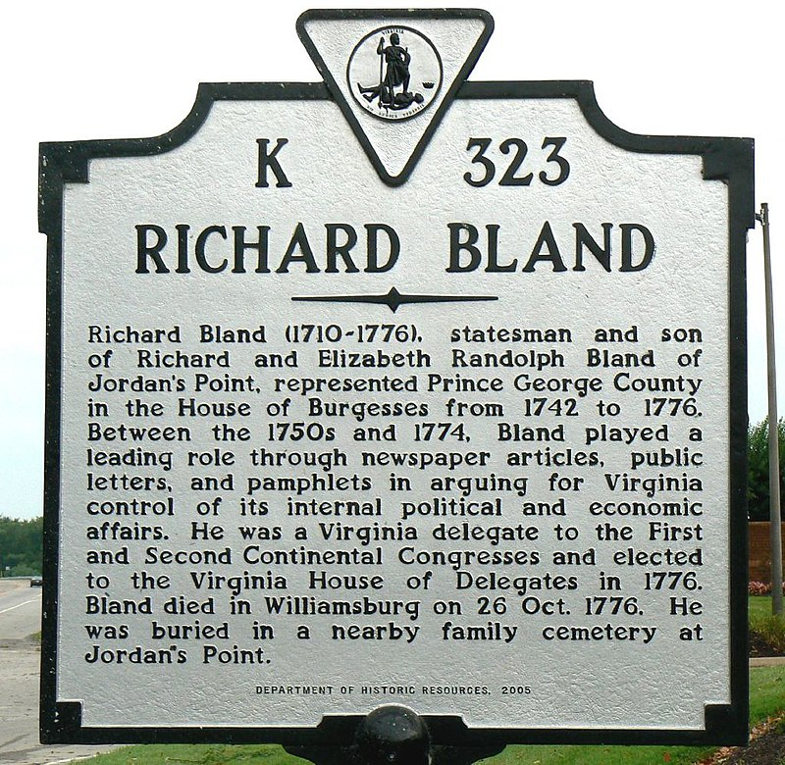
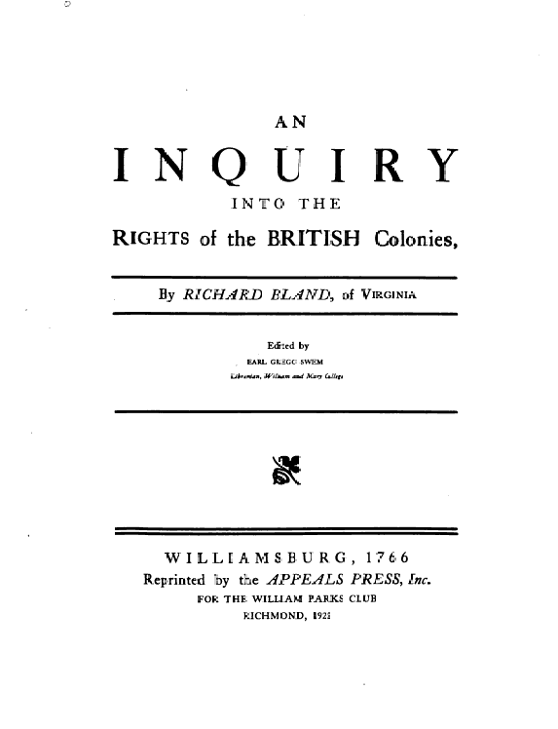
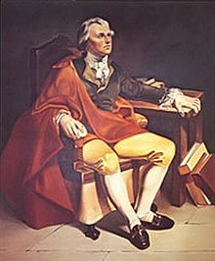
How Bland County Got Its Name
Our County was named for Richard Bland, contemporary of Thomas Jefferson and George Wythe. He lived at Jordan’s Point on the James River in Prince George County near Hopewell. He had 3 wives and 12 children.
He wrote one of the original documents stating the rights of man: An Inquiry into the Rights of the British Colonies. Most vocal of all the Revolutionalists.
He attended the first two Continental Congresses in Philadelphia, but due to ill health did not attend the 3rd when the Declaration of Independence was signed. He died of a stroke while walking in Williamsburg later that year in October of 1776
Somewhat of a mystery why this name was chosen. Many thought since he was a compatriot of George Wythe for whom an adjoining county was name, it would be appropriate to name a county after him.
In 1858 a document appeared stating a county should be named for him.
The name Bland is listed 25 times in the act to form our county, but no reason is given for choosing the name.
As far as we know, none of the Bland family ever settled in Bland County, although we often get inquiries from some of his descendants.
Richard A. Bland 1710 - 1776
Notes:
One of the mysteries is why Bland was chosen. He had no apparent ties to the county. He had died almost 85 years previous to the name being chosen.

Slide 23
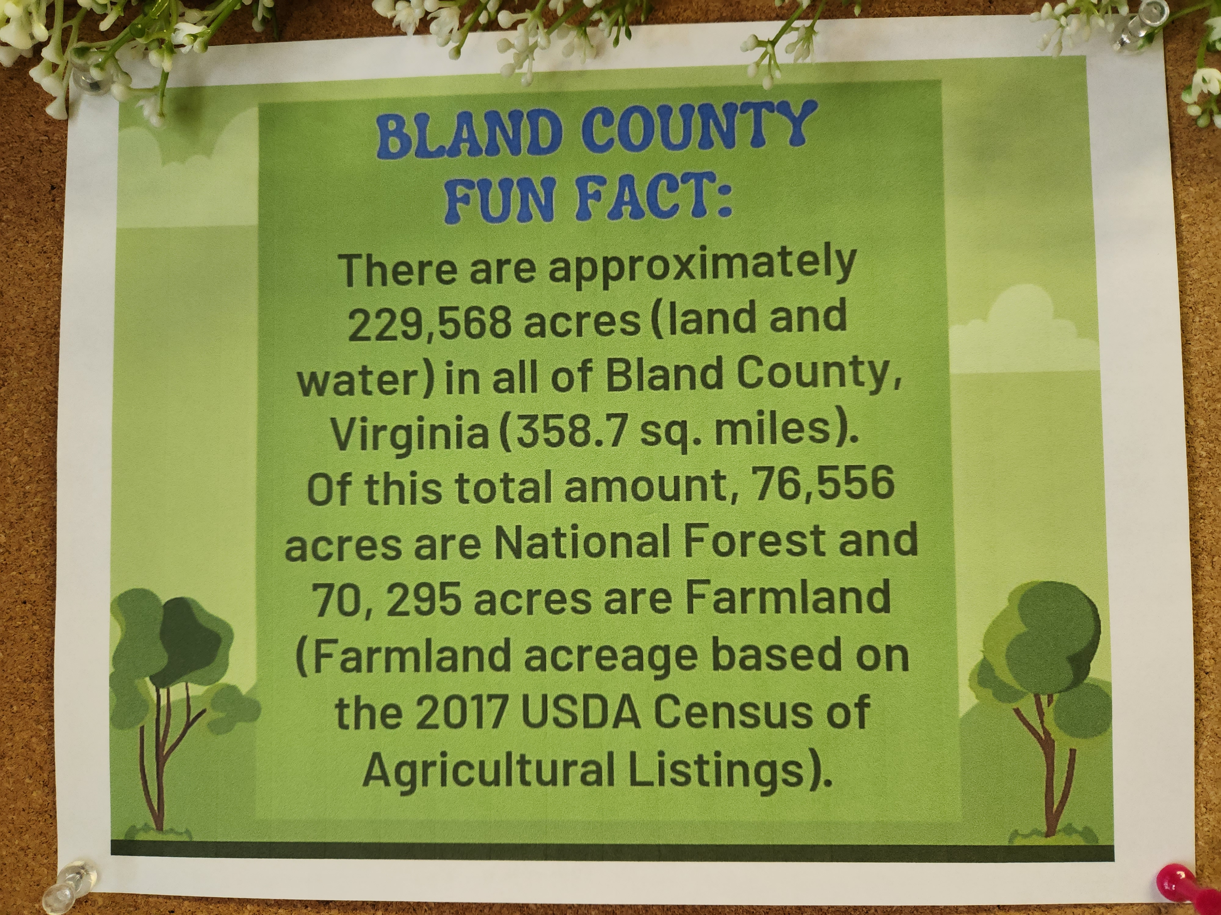
The Land called Bland County: Statistics
Total Acreage in Bland County (Land and Water) = 229,568 acres (~359 square miles)
Total Acreage in Land = 227,272 (99%)
  Land used for Farmland = 70,295 (31%)
  Land in National Forest = 76,556 (34%)
Total Acreage in Water =2,296 (1%)
Land Area Rank Among VA Counties = 52nd
^{(out of 133 counties)}
Original Boundaries have been stable with the exception of the land near Madison Allen’ farm (Jane Allen’s grandfather) land that included present day Bland Correctional Farm. Mr. Allen requested that the land to granted to Bland from Giles in about 1890.
Bland County Historical Society Farm Exhibit, 2023

Slide 24
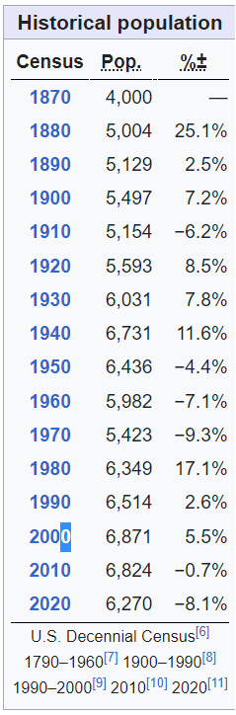
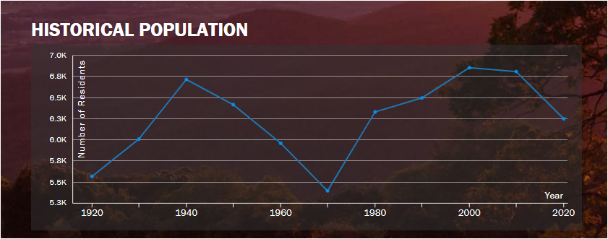
Bland County: Population (1920 – 2020)
Bland County’s Population from 1870 through 1940 rose, but fell
from 1940 until 1970 when it started to rise again. Fell again beginning in 2010
Bland County ranks 127th in population out of 133 counties in VA – only 3 counties with smaller population. Highland, Bath, and Craig
Low Population Density: 17 persons/sq mile/Bland County
210 persons per sq mile/Virginia
96 persons per sq mile / United States

Slide 25
First Organizational Meeting of Bland County
August 15, 1861
First officials:
  Surveyor: William G Mustard
  Commissioner of Revenue: Franklin I Suiter
  Sheriff: Samuel N. Newberry
  Deputy Sheriff: Harman Newberry
  Commonwealth’s Attorney: William N. Harman
  Justice of the Peace: William Groseclose
  Overseers of the Poor: Randolph Hall and Joseph Fanning
Other Actions
  Appropriated the sum of $1,520 to August Wesendonck for use by the volunteers from the Bland units in the Civil War – to equip with horses, feed, clothe, etc.
  Authorized the use the house of James W. Grayson to be used as temporary courthouse until one could be built

Slide 26
Secession – 3 Week After Bland’s Formation
April 17, 1861
Virginia seceded from the Union just 3 weeks after the County of Bland was formed on April 17, 1861.
There had been 2 secession votes, one earlier in January, that failed.
Peace Conference intervened but peace did not ensue. President Lincoln called on all states that had not seceded to raise 75,000 troops and invade states that had not seceded. That was the proverbial “straw that broke the camel’s back.” Virginia governor called another secession vote.
Secession votes were cast by representatives from Giles, Tazewell and Wythe since a representative had not yet been appointed for Bland County
  Manilius Chapman (Giles) voted yes
  Samuel L Graham (Tazewell) voted yes
  Robert C Kent (Wythe) voted yes

Slide 27
First War for Bland County Citizens
American Civil War (1861 – 1865)
April – June, 1861 – Home Guards or Militias were formed in Bland (listed on pages 264 -276 ) History of Bland County – No accurate count of how many people served in Confederate Army, but best estimate is about 300.
Two County officials had to be replaced because of their role in the war. Samuel H Newberry as Sheriff by his brother, Harmon Newberry, and Franklin I. Suiter by James Finley as Commissioner of Revenue
1861 – 1865 – Civil War rages
  Skirmishes in Bland, but no significant battle
  Troops from North Passed Through on Way to:
    Toland’s Raid in Wytheville
    Battle of Cloyd’s Mt. near Dublin at end of War
    Bland stood between North and West Union Armies and 3 strategic locations: Salt Deposits near Saltville, Railroad at Dublin Depot, Lead Mines near Wytheville
  No accurate number on loss of life or wounded among Bland County Citizens, but there were many.
April 9, 1865 – Surrender at Appomattox

Slide 28
First Time Residents of VA Lived Under Military Rule
Post Civil War (1865 – 1870)
1865 – 1870 – All of Virginia was under Military Rule from end of war until January 26, 1870. General John Schofield was appointed military governor of VA
After the war, the county faced challenges in rebuilding its economy and infrastructure. However, there was not as much damage to Bland County after the war.
Due to the worthlessness of Confederate money, paying taxes presented difficulty and land changed hands. Wessendonck’s brother, Otto, paid his taxes in GOLD. Otto also paid taxes for neighbors and acquired the land. Many Yankees came to the area, paid the taxes and became owners of large tracts of land. Example: Kimberling Springs Resort first known as Booth’s Healing Springs.
1866 – First County Building – the Jail is built. Military rule officials must have felt they needed a place to put the unruly, criminals, etc. Many rogue elements were roaming country.
1867 – 1869 The former Confederate states were required to ratify the Fourteenth Amendment, which defined citizenship and the rights of citizens in the U.S. Constitution, before re-admission to the Union,. Virginia rejected the 14th Amendment in 1867. In 1869 Virginia adopted a new state constitution that acknowledged the rights of black men to vote and run for office. The General Assembly ratified the Fourteenth (citizenship for all) and Fifteenth (right for African Americans to vote) Amendments in October 1869.
1870 – Virginia was readmitted to the Union on January 26, 1870 when Congress passed the act to admit the state of Virginia with representation in Congress.

Slide 29
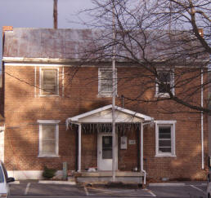
First County Building Constructed : County Jail
1866
Old Jail Built in 1866
Operated for about 130 years as a jail
Contract let on August 29, 1866 with to James V. Pendleton
Cost of Construction was $4,700 ($60,000 in today’s money)
It was used as residence for the county sheriff and/or jailor – 2 story brick building with jailor living on the first floor
Red Brick Structure still in use as the headquarters of the Bland County Historical Society

Slide 30
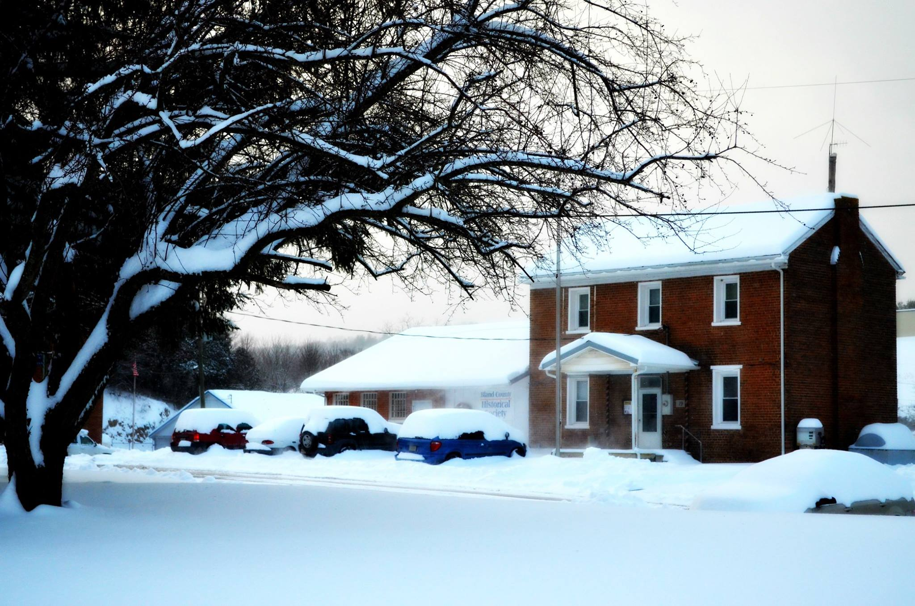
Subsequent Changes to the County Jail (1953, 1974-1981, 2004)
New Jail Annex Built in 1953 by Associated Contractors at a cost of $23,250 ($163,000 in today’s money)
New Annex had 6 cells with toilet facilities with a processing room and shower in front of the cells
Jail was closed for seven years from 1974-1981 due to “shortcomings.”
Reopened May, 1981
May 2004 Bland County Jail closed permanently when began to use New River Valley Regional Jail in Dublin
Bland County Historical Society Opens in Jail October, 2009
Photographer, Goldie Kiser

Slide 31
1st Murder in Bland County
October 25, 1869

Slide 32
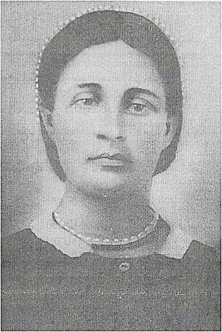
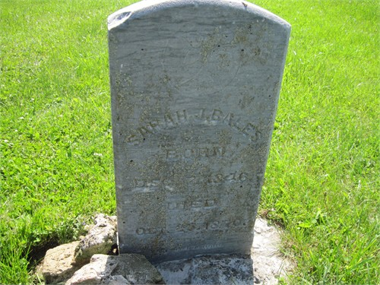
Victim 1: Sarah Jane Bales – Ceres VA
Daughter of: James Rothwell Bales and Mary M. (Molly) Perkey
Residence: Hollow near Everett and Alma Waddle’s place on the way to Ceres (across from present day Eupepsia)
Age at Death – 24 years old
Left Home late on the afternoon of October 25 to visit a neighbor
Stopped along the way to pick chestnuts
Found her the next day lying under a tree with chestnut in her mouth
One of the first Burials at Red Oak church Cemetery, but she was buried outside the fence
Date of Death on tombstone reads 10/25/1870*
*(should read 1869)
Sarah Jane Bales (Dec 7, 1846 – Oct 25, 1869)

Slide 33
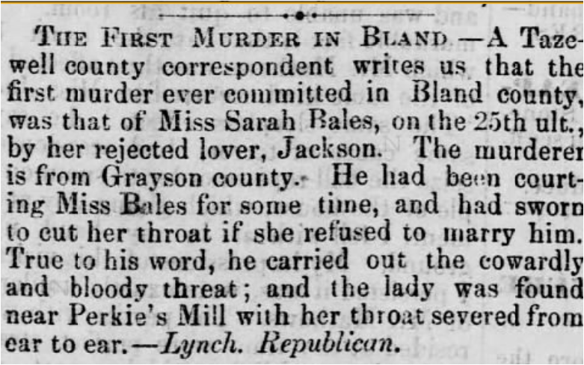
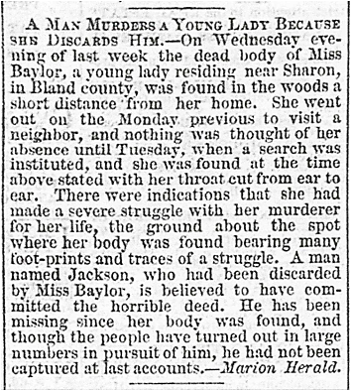
1st Murder in Bland County
October 25, 1869
Staunton Spectator – Nov 16, 1869
Marion VA Herald – Nov 5, 1869

Slide 34
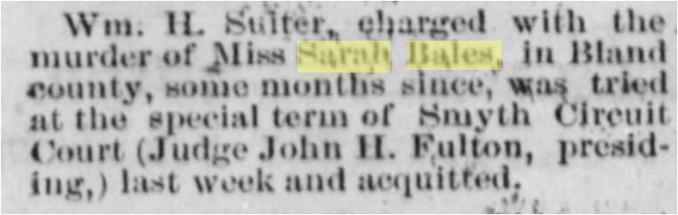

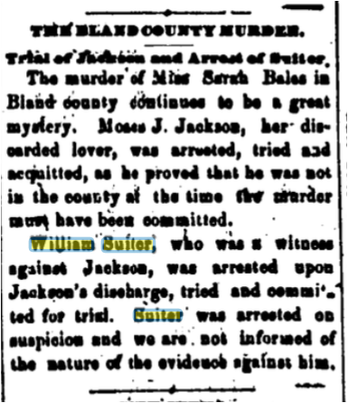
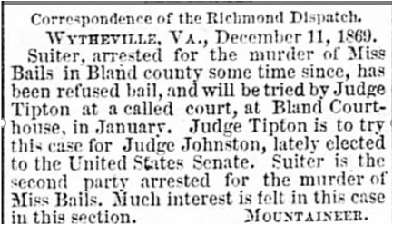
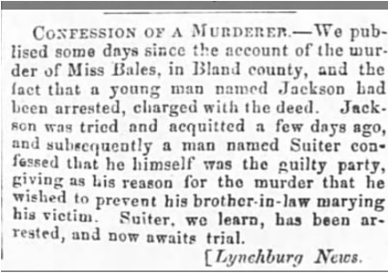
Newspaper Articles: First Murder in Bland County
Sarah Jane Bales - October 25, 1869
December 9, 1869, Rockingham Register
Bristol News – July 1, 1870
Staunton Spectator – Nov 16, 1869
Lynchburg News - November 18, 1869
December 11, 1869
Bristol News 11/26/1869

Slide 35
The Accused: Moses J. Jackson (Acquitted – 11/1869)
William Henry Suiter (Acquitted – 6/1870)
Moses J. Jackson (Grayson County)
Sarah Bales’ spurned lover
Purported to have been courting her for sometime and had told her he would slit her throat if she refused to marry him.
Acquitted, out of Bland County at time of murder
Brother in law of William H Suiter who had testified that Moses Jackson was the killer, confessed, arrested and put in the Bland County Jail
William Henry Suiter (Bland County)
At the trial of Mr. Jackson, William Henry Suiter confessed that he had killed Sarah Bales to keep her from marrying Mr. Jackson
Trial held in June 1870 Term of Court in Smyth County.
Jury Trial took 3 days. Deliberation several hours. Verdict: Not Guilty
No details of trial available as to evidence presented
No reason given as to why he was acquitted

Slide 36
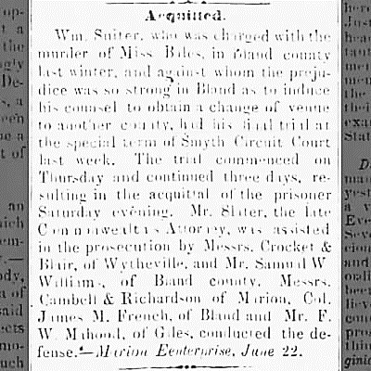

First Bland County Trial by Jury – June, 1870
Marion, Smyth County VA
After Moses Jackson was acquitted and William H Suiter confessed and jailed, trial was moved to Marion in Smyth County. William Suiter remained in jail as best we can tell. A change of venue was requested by his lawyers because of “strong feelings” about the case in Bland County.
Bristol News – July 1, 1870
Wm. H. Suiter charged with the murder of Miss Sarah Bales, in Bland County, some months since was tried at the special term of Smyth Circuit Court (Judge John H. Fulton, presiding,) last week and acquitted.
Jan 6, 1870 Rockingham Register
June 24, 1870 – Abingdon Press

Slide 37
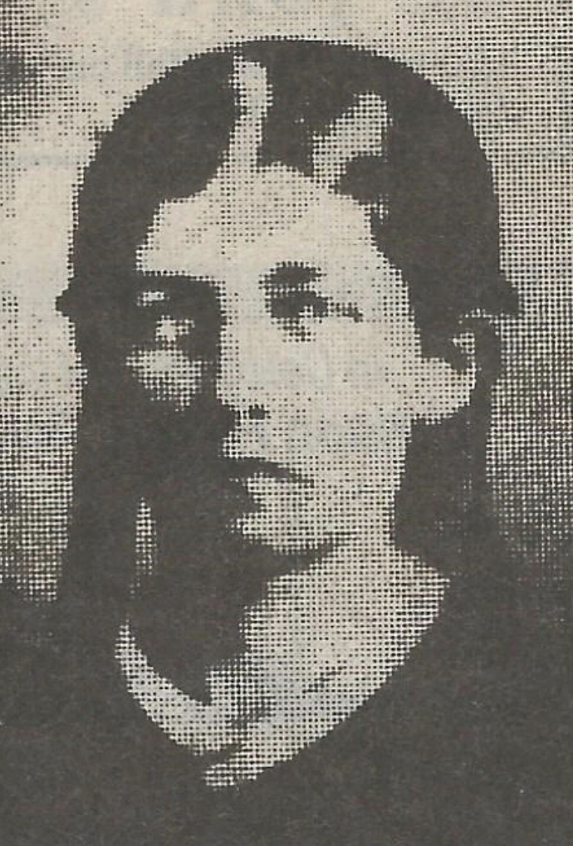
Victim 2: Lucretia Heldreth Hedrick (Stony/Guillon Fork, Wythe County, VA)
Daughter of: William Heldreth and Nancy Riggle
Wife of: Rufus Jagalong Hedrick (father of William Suiter’s Wife, Sarah Jane Hedrick. Therefore, Lucretia Hedrick was Suiter’s step mother-in-law)
Age at Death: 46 years
First Reports - many thought she may have committed suicide – Found lying on floor of shed with arms crossed over her chest. Nothing missing and she had some change in a small purse she carried.
Coroner’s inquest and doctors’ examinations showed that she had been strangled with a horse harness
VA Governor Walker offered a $100 reward for the arrest of William H Suiter
(Lucretia Heldreth Hedrick 1825 – 1871))

Slide 38
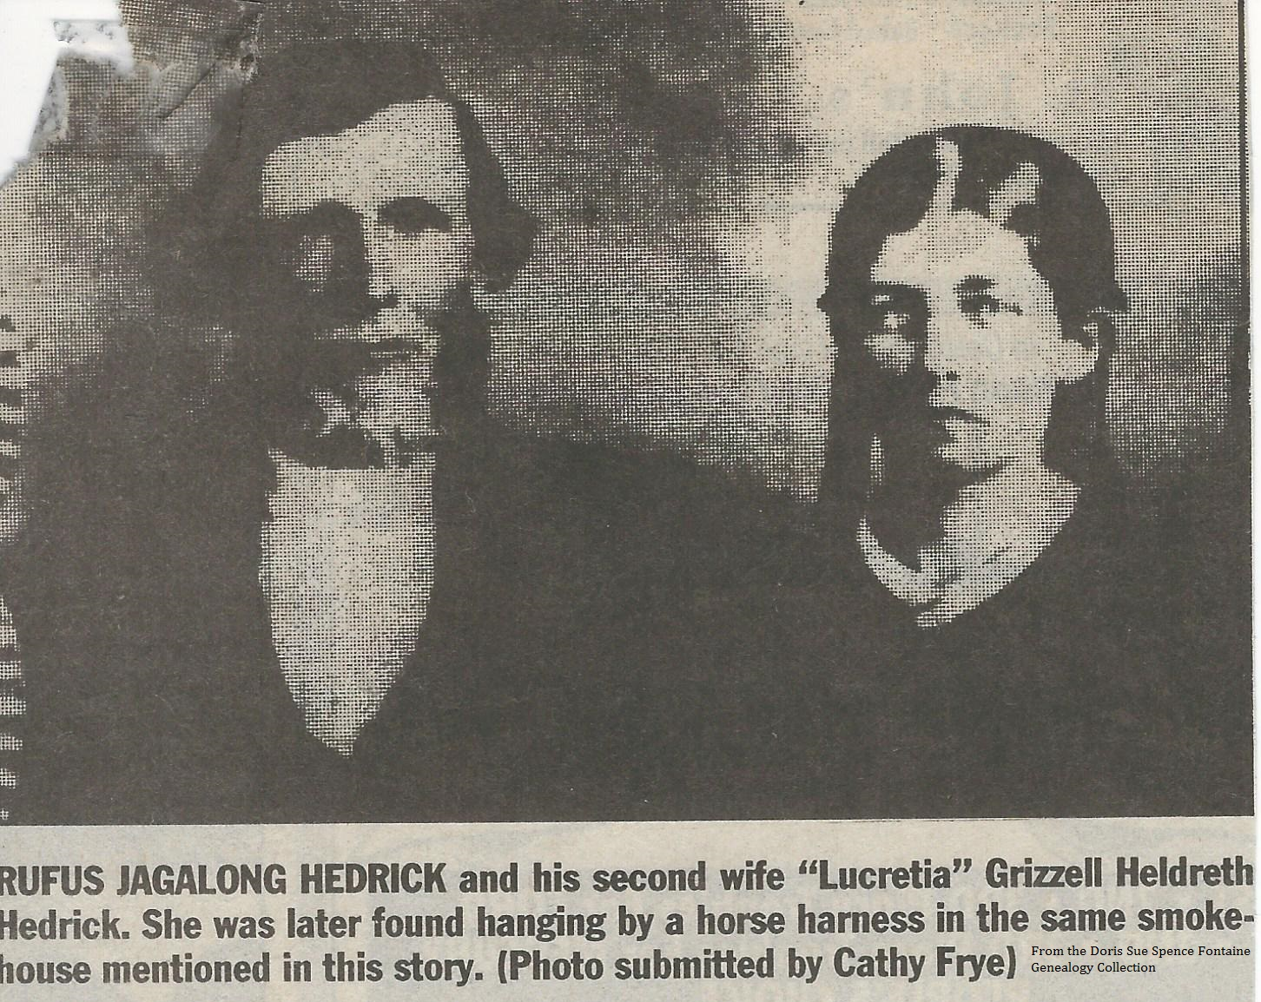
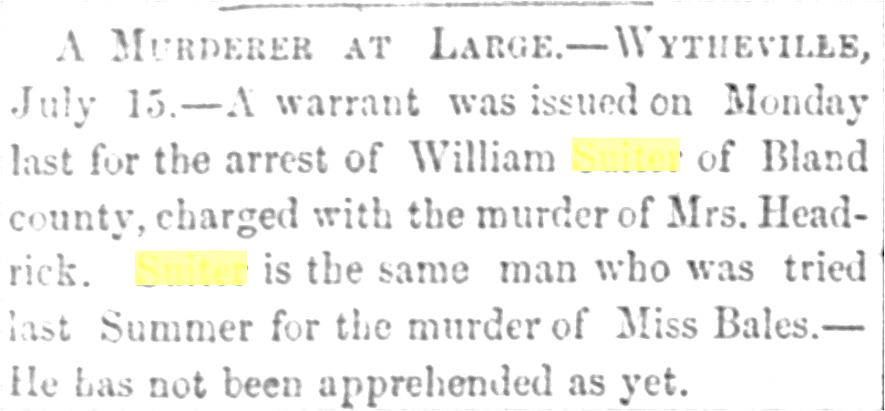
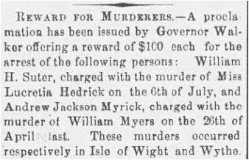
Newspaper Articles: 2nd Murder by William Suiter of Lucretia Heldreth Hedrick - October 25, 1869
July 22, 1871 – Virginia Free Press

Slide 39
The Accused: William Henry Suiter
William Henry Suiter (Bland County)
Was spotted near scene of crime in Stony/Gullion Fork, Wythe County
Warrant Issued for William Henry Suiter’s arrest
Governor of VA Walker offered a $100 reward for his capture and offered a description of the accused and described him.
July 1872 Newspaper article reporting that his remains had been found. Reportedly shot by a posse or by himself.
1874 declared dead in Bland County Court Orders and assets
  Turned over to the Sheriff’s Office
He had married Sarah Jane Hedrick in 1863, they had 4 children, all are listed in the 1870 census. In 1880 they are scattered around Bland County as orphans, servants
Sarah Jane Hedrick died sometime between 1872 and 1880, but have found no record of her death
**Son of: Alexander and Mary “Polly” Newberry Suiter
Some confusion of whose son he was – because he
disappears from the family tree after the murders. He is probably the brother of Franklin I Suiter, whose was Sheriff of Bland County at the time.
Son of my 2nd great grandmother’s sister

Slide 40
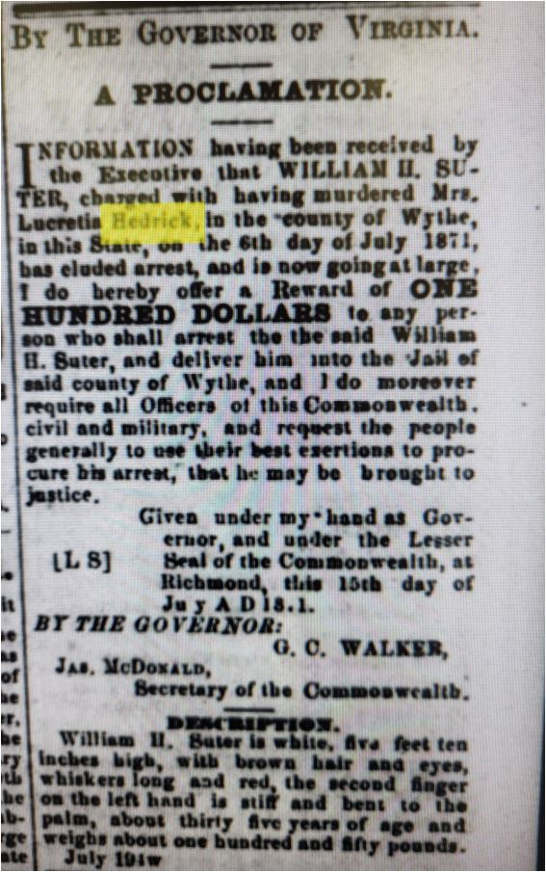
Reward for Capture of William H Suiter
July 15, 1871
By The Governor of Virginia
A Proclamation
Information having been received by the Executive that WILLIAM H. SUTER (sic), charged
With handing murdered Mrs. Lucretia Hedrick, In the “county of Wythe,” in this State on the 6th Day of July 1871, has eluded arrest, and is now going at large, I do hereby offer a Reward of ONE HUNDRED DOLLARS to any person who shall arrest the said Wiliam H Suter (sic), and deliver him to the said county of Wythe, and I do moreover require all Officers of this Commonwealth, civil and Military, and request the people generally to use their best exertions To procure his arrest, that he may be brought to justice.
Given under my hand as Governor and under the Lesser
Seal of Commonwealth in Richmond, this 15th day of July A. D. 1871.
BY ORDER OF THE GOVERNOR:
G. C. WALKER
Jas. McDonald, Secretary of the Commonwealth
Description
William H. Suiter is white, five feet ten Inches high, with brown hair and eyes, whiskers long and red, the second finger on the left hand Is stiff and bent to the palm, about thirty-five years of age and weighs about one hundred and fifty pounds. July 1871
Southwest Virginia Enterprise July 1871

Slide 41
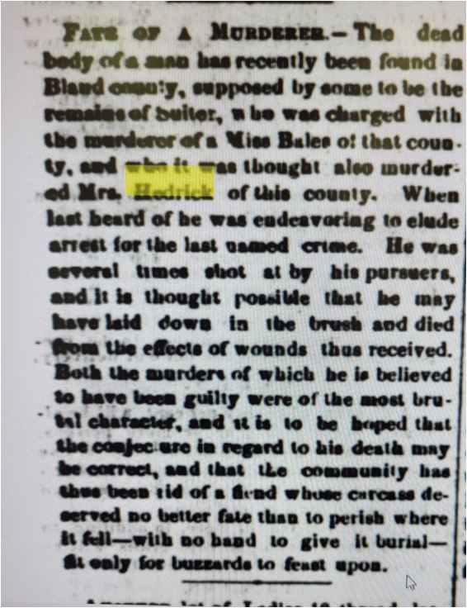
Fate of the Murderer
(Wythe Enterprise 9/25/1872)
Fate of the Murderer – The dead body of a man has recently been found in Bland County. Supposed by some to be the remains of Suiter, who was charged with the murder of a Miss Bales in that county, and who was thought also murdered Mrs. Hedrick of this county. When last heard of he was endeavoring to elude arrest for the last named crime. He was several times shot at by his pursuers, and it is thought possible that he may have laid down in the brush and died from the effects of his wounds thus received. Both the murders of which he is believed to have been guilty were of the most brutal character, and it is to be hoped that the conjecture in regard to his death may be correct, and that the community has thus been rid of a fiend whose carcass deserved no better fate than to perish where it fell – with no hand to give it burial - - fit only for buzzards to feast upon. Wythe Enterprise 9/25/1872

Slide 42
Victim 3: ??????
Only alluded to in newspaper article in 1990 and in a note on Find A Grave
Unfortunately the trail went cold after murder of Lucretia Hedrick.
Next indication was body found in area where the posse had tracked and shot at Suiter.
Could not find any further trace of Sarah Hedrick Suiter, his wife, in Census data, some reports are that his wife died in 1875. They had 2 more children after 1870.
Next record of William and Sarah Hedrick Suiter is found in the will of her father, Rufus J. Hedrick where her children are named as heirs and that she is deceased.

Slide 43
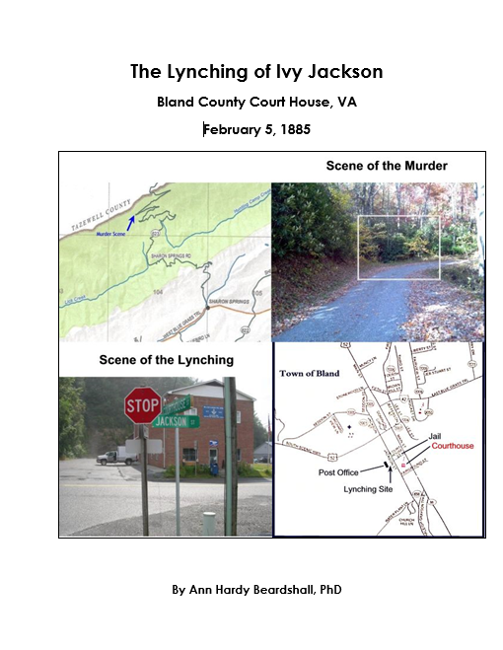
Other Notable Crimes in Bland County – 1885

Slide 44
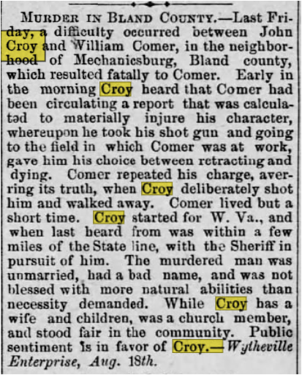
Other Notable Crimes in Bland County – 1886
1886 - John Croy (teacher) shot and killed Will Corner in Mechanicsburg
Motive: Slander about Croy’s character
Paper reported that Will Corner “was not blessed with more natural abilities than necessarily demanded”
Paper also stated that “Croy has a wife and children, was a church member and stood fair in the community. Public sentiment is in favor of Croy.”

Slide 45
Other Notable Crimes in Bland County – 1889
Sarah Ellen King Gills killed brother in law, Wesley Gills, in Little Creek
  Gills Murder (1889) “news reached here Thursday night at Wesley Gills had been killed by his brother’s wife. All of the parties live on Little Creek of this county. . . Mrs Gills was at the house of her father, Solomon King, when Wesley Gills came to the house and after some time told the woman that he intended to kill her. He grabbed and jerked her out of the house and made for a rock, with which, it is supposed he meant to hit her. She rushed into the house and armed herself with an axe and when he returned she struck him on the neck, severing the jugular vein from which he he died almost instantly. This is the story of the woman.” James Wesley Gills, brother was William Gills and his wife Sarah Ellen King Gills, was the one accused of killing Wesley. Sarah’s case was tried in Bland County and she was found not guilty. “

Slide 46
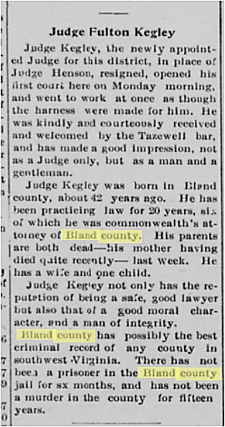
Lull in Bland County Crime
(cited Tazewell Paper)
circa 1905
When Judge Fulton Kegley Appointed Judge in 1905, the state of crime in Bland County was reported as:
No prisoner in the Jail for the last 6 months (first 6 months of 1905)
No murder in Bland County for the last 15 years. 1890 - 1905

Slide 47
Other Notable Crimes in Bland County
20th Century
1943 - Shewey Valley Suicide-Murders (Rexa Kitts purported to have killed father, daughter, son in law and self)
1949 - Murder of Kathryn Newberry (Brothers Sam and Jack Newberry convicted of having Jack’s wife, Kathryn)
1970 – Court House Murder of Judge Pierce Kegley (Charlie Jarrell killed Judge Kegley at the Bland Corthouse over his sentencing Jarrell to prison for failure to pay child support)
Sarah Francis (White Gate Murder) by an escaped convict from the Bland Correctional Farm
Claudine Farmer Waddle Murder – Killed by two men from WV with robbery in mind, killed, raped, and burned her house.
In mid to late 20th century – around the time the tunnels opened the size of the sheriff’s office increased dramatically due to stops for drug trafficking, crimes committed in other locales.

Slide 48
Crime in Bland County – 2021
Headline: Bland was a safe place to live in 2021
Bland County, with a population of 6,210 citizens, saw 89 total Group A offenses, with 14 drug cases and other various offenses in the single digits. Much less crime in Bland than surrounding counties.
Bland County violent crime rate is 9.5 rate, compared to a US average of 22.7
Bland County property crime rate is 22.8, compared to a US average of 35.4

Slide 49
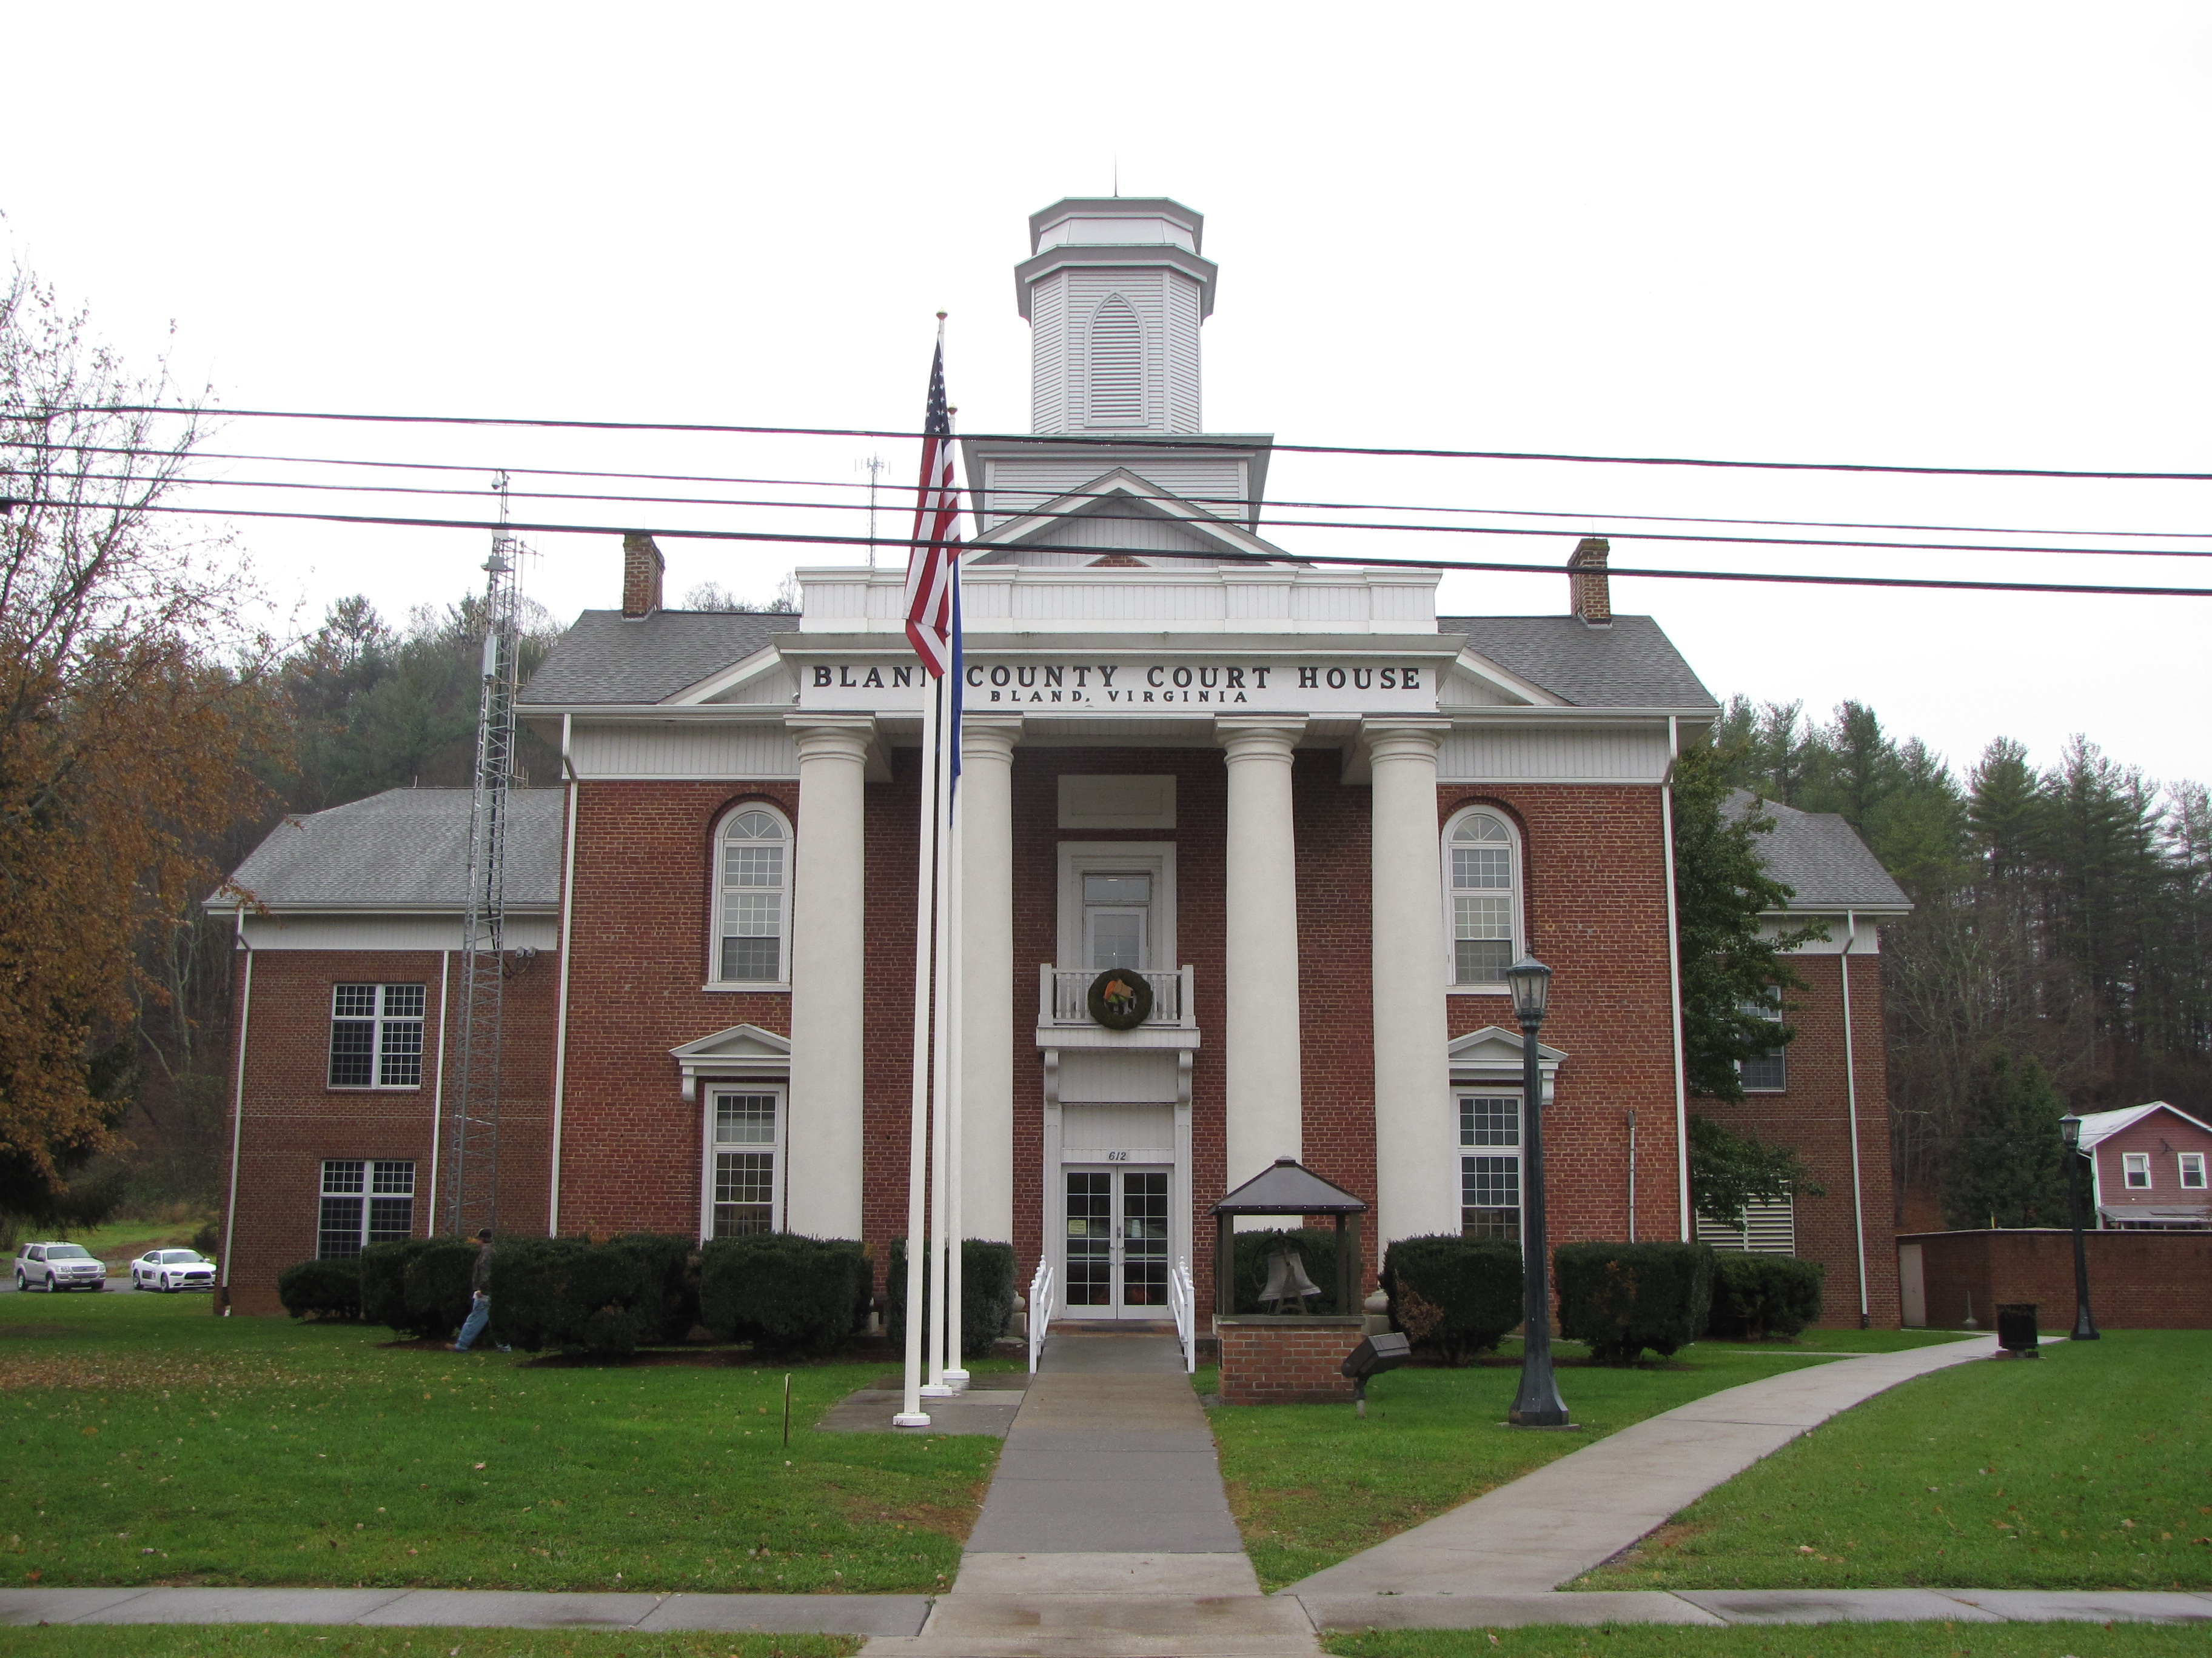
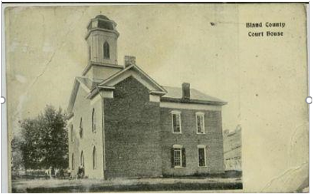
The First Bland County Court House
1879 - 1888
Building Started in 1875, Finished in 1879
Land was donated by James and Emily Steele Grayson
Cost was $9,497 (~$287,000 in 2022 dollars)
Original Court House burned on December 5, 1888. Many legal documents burned, but citizens brought in handwritten deeds and they were rewritten. Marriage indices were saved but not the certificates themselves.

Slide 50
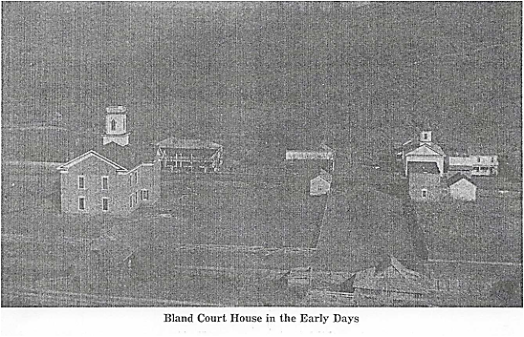

Slide 51
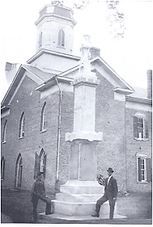
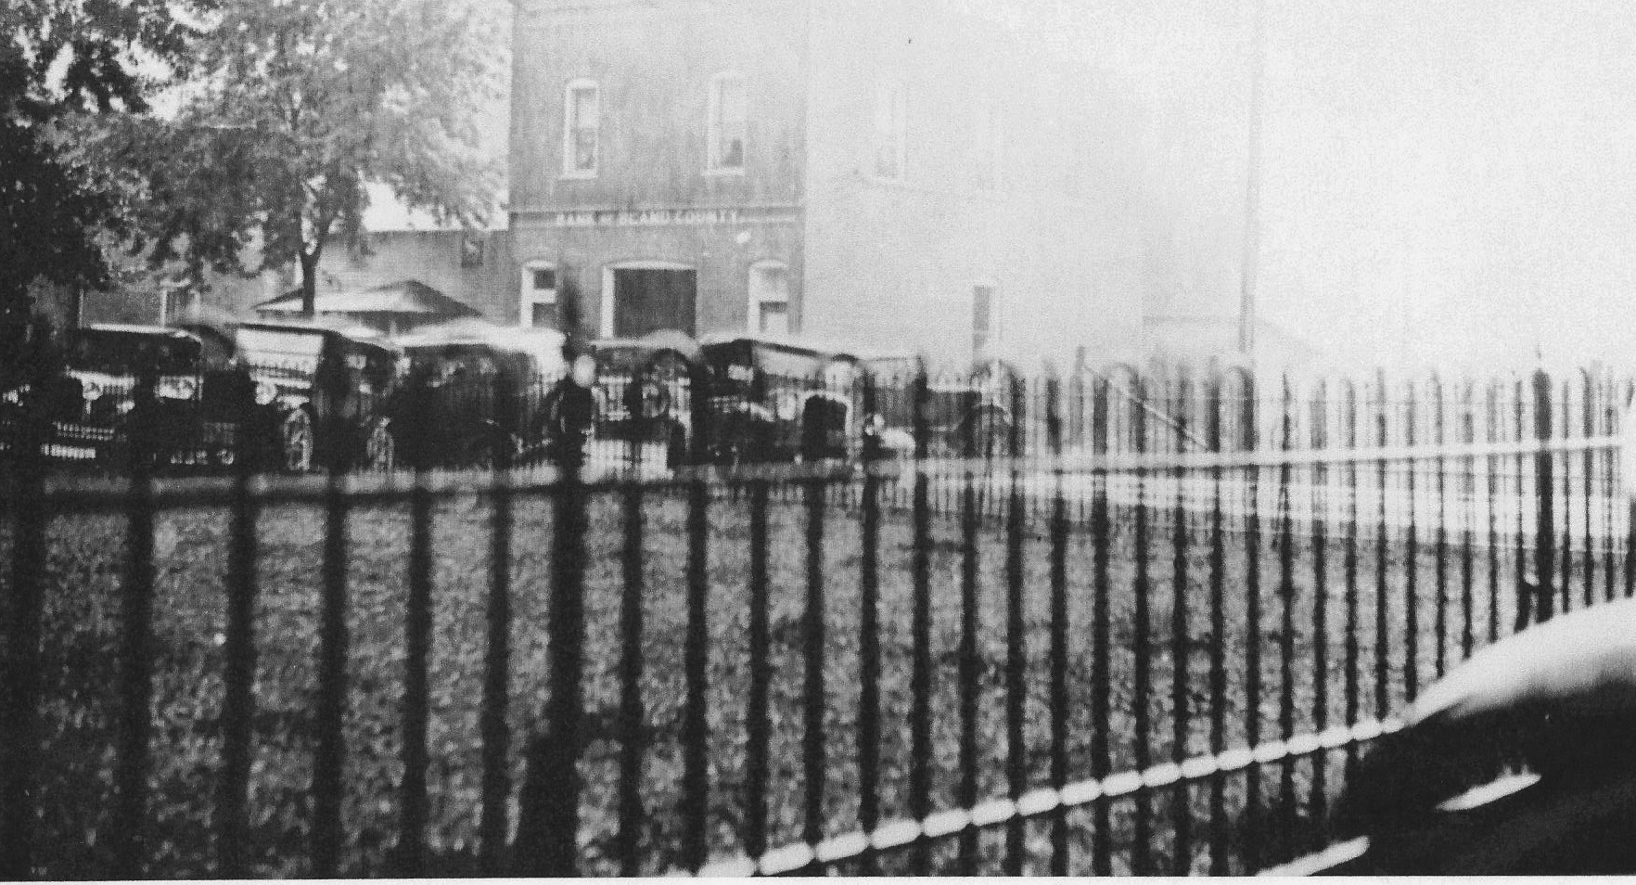
Rebuilt Bland County Court House
1888 - 1929
Rebuilt on old foundation
Specification were similar to the original structure
Cost of Rebuilt Court House completed in 1889 was $ $6,978 (~$229,000) in 2022
Surrounded by a wooden fence, wrought iron fence, and a post and cable fence
1912 Daughters of the Confederacy added the Confederate Soldier Statue Mrs. Fulton Kegley SR led the campaign. Statue was shipped from Italy to Wytheville, brought over mountain by horse transport. (Good account on BCHS website)
After 1912
Cars parked by wrought iron fence parked around
Court House in the 1930s

Slide 52
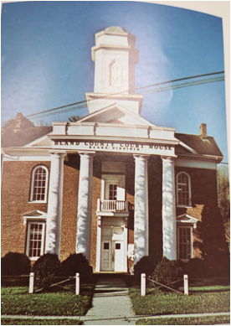
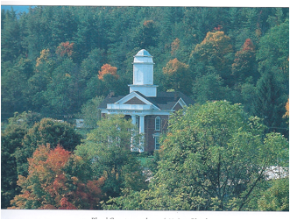
BLAND COUNTY COURT HOUSE
(1929 – 2002)
Portico was added in 1929
1949 addition built on the back of the Court House. This addition was torn off during remodeling in 2002.
Bell in belfry rang twice in my Bland life: end of WWII and death of FDR
Area to the right side (facing) was a favorite play area for Bland children

Slide 53
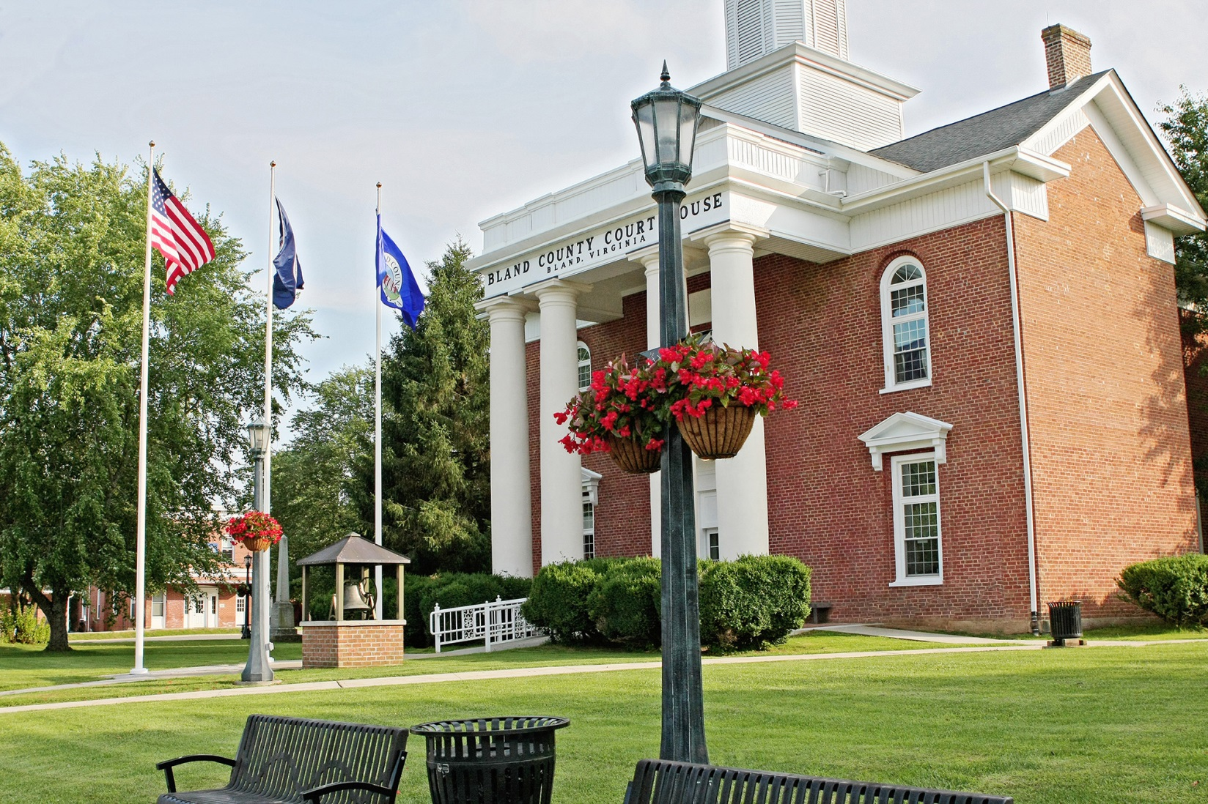
BLAND COURT HOUSE
(2002 - Present)
Remodeled to the tune of $3.4 Million ($5.2 Million in 2022 dollars)
Bell removed from tower due to weight and special housing enclosed it on walk leading into the courthouse
3 Flag Poles: USA, State of VA, and County of Bland
Fences were removed

Slide 54

Grazing on the Bland Courthouse Lawn
Courthouse has been surround by split rail, plain wood fence, wrought iron fence, post and cable and now no fence at all. In the early days there are many reports of a fence being needed to keep the animals (in or out). There is one account of someone paying to allow their animals to graze on the Courthouse lawn, particularly when horses were a common mode of transportation. Picture taken in 2015 of deer grazing on the Bland Courthouse Lawn.

Slide 55

The First Governing Districts for Bland County
County outline shown is very similar to the original 4 districts:
Purple: Rocky Gap District
Lavendar: Sharon District includes Ceres/Bastian
Brown: Mechanicsburg District includes Hollybrook/Mechanicsburg
Blue: Seddon District includes Bland/Davis (Little Creek)
Note: Bland County has no incorporated towns.

Slide 56
The First Settlements Bland County
First Areas of Bland County having significant settlements:
Bland Area: formerly Crab Orchard, then Seddon, then Bland Courthouse, final just Bland
Ceres Area (Sharon Springs) Area: formerly Bear Garden, named Ceres in 1870s by father of Henry Groseclose
Mechanicsburg Area: Named for the “Mechanics” On the Walkers Creek Holston Turnpike
Rocky Gap Area: Named for extremely rocky area at the gap of East River Mountain just a mountain away from Bluefield
Hollybrook Area: Named by Henry Harman SR (Old Skydusky) for the holly bushes/trees growing around his home.
Transportation continued to be a problem in the early days and as a result self-sustaining settlement were formed

Slide 57

Place Names Map
(Louise Bird - 1961)
Pumpkin Center
Rabbit Squat
Shake Rag
Lick Skillet
Gobblers Knob
The Slide
Crackers Neck
Carnot
Grassy Branch
Effna

Slide 58
Primitive Roads at the time of Formation
Red Route=Raleigh/ Grayson Turnpike
Blue Route =Walkers Creek/Holston Turnpike
These roads were very narrow, unpaved, foot or horsepaths

Slide 59
First Roads in Bland County
Lack of good roads was impetus for forming Bland County
Two main roads at the time of founding
  Walker’s Creek/Holston Turnpike – basically Rt 42 through the county, now called Blue Grass Trail
  Raleigh Grayson Turnpike – from Raleigh County (Beckley) WV to Grayson (Independence) VA
    Through Bland County, over East River Mountain, through Rocky Gap, then Bastian, Bland, over Big Walker to Carnot in Little Creek, over Smith Hollow Road and onto Wytheville
    Was the North-South Route through Bland County until Hwy 21/52 was built – Great Lakes to Florida Road starting in the 1930s
Once Bland County was formed, citizens developed communities that were fairly self contained and there was little road building until the late 1930s.
There were no paved roads in Bland County until the 1930s
Concerns from surrounding counties

Slide 60
Primitive Roads at the time of Formation
Red Route=Raleigh/ Grayson Turnpike
Blue Route =Walkers Creek/Holston Turnpike
These roads were very narrow, unpaved, foot or horsepaths

Slide 61


Amusing Account of Condition of Roads
Bland County - 1916
Clinch Valley News 2/4/1916
Clinch Valley News 2/11/1916

Slide 62



Pictures of the Early Roads (early 1900s)
Main Street in Bland
Old Mountain Road from top of Big Walker down to Ceres
Main Street in Mechanicsburg

Slide 63


Early Communities of Bland County - Bland
Bland chosen as County Seat because of its centralized location and, at the time, the intersection of the two major roads: Walkers Creek Holston Turnpike (Rt 42) and the Raleigh Grayson Turnpike (Beckley to Independence) AKA Turkey Turnpike
Originally called
  Crab Orchard for the creek that flows through Bland
  Seddon after Senator Seddon who helped with the legislation to form the County (also Secretary of War for CSA)
  Bland Courthouse
  Bland
1872 Description of Bland (still called Seddon or Crab Orchard)
  1861- Civil War – 1 hotel and 1 private dwelling in Bland
  1872 – 30 private dwellings, various stores and shops, a church,
  Masonic Hall, first rate jail and a fine Court House under construction (SWVA Enterprise, 4/27/1872)

Slide 64


Early Communities of Bland County - Ceres
Probably the oldest community in Bland County – Church records indicate settlement as early as 1821
First name for the community was Bear Garden
1880 – Capt. Henry Groseclose – father of Henry C. established a Post office and renamed the town, Ceres, after the goddess of grain and agriculture.
1870 – 1880 Sharon Springs, a Healing Resort at Effna
1892 – 1901 Sharon College, a private school that included high school and college prep

Slide 65


Early Communities of Bland County – Rocky Gap
Named for the rocks abundant at its location in the gap of the mountain
Prescient words about Rocky Gap in 1912: . . .”It is the only place in this neighborhood where it is possible to get through the mountains without having to climb over the tops of them or tunneling through and this natural advantage will make it a desirable place when the time comes for the development of Bland County.”
Article on paper when N & W nearing completion of railroad from Narrows to Rocky Gap (1912)

Slide 66

Early Communities of Bland County - Mechanicsburg
Mechanicsburg was laid off in lots in 1832 long before Bland County was formed
Walkers Creek/Holston Turnpike went right through the middle of town
Named using the old definition of a “mechanic” = one who is employed in manual labor, one who works mechanically, a handicraft worker, an artisan
Hotel, harness shop, feed store, general store, millinery shop, jewelry store, bank to serve travelers and Mechanicsburg populace.
After roads improved Mechanicsburg population decreased from a high of about 150 To 81 between 1920-2020

Slide 67


Notable Firsts: First School After the Founding of Bland County
Point Pleasant Academy - 1866
Rev. G. W. Penley’s School circa 1888-1890
Point Pleasant Academy
First School – Point Pleasant Academy – GW Penley
(Brenda Havens photo)

Slide 68
Education in Bland County
Pre-1861 – 1870 – Most schools were subscription schools
1870 – VA made public schools mandatory
1871 – 17 schools with an enrollment of 704 schools
1922 – School Board for counties with rep in each magisterial district
Year | Number of Schools | Number of students | Number of Teachers
1872 | 29 | 1235
1922 | 30 | 1417 | 47
1930 | 30 | 1502 | 53
1950 | 9 | 1445
1960 | 7 | 1362 | 53
2023 | 2 | 719 | 104
School | Year Built | Cost
Mechanicsburg Elem. | 1909 | $1,500
Bland High | 1917 | $9,600
Hollybrook High | 1927 | $4,000
Rocky Gap High | 1931 | $7,000
Ceres High | 1931 | $2,000
Bastian Elementary | 1955 | $112,215
Rocky Gap High | 1955 | $236,265

Slide 69



Notable First: Healing Springs Resorts
Kimberling Springs Resort
1854 - 1880
Also one located at Sharon Springs
after the Civil War

Slide 70


Notable Firsts: First Train in Bland County
Giles County to Rocky Gap (1912)
Rocky Gap to Suiter (1914)
Played important role in carrying out manganese and especially timber from Bastian
Served as transport for men to the CCC Camp in Bastian
Passenger Service between Bland and Giles County (Narrows) – 1919
Train Service discontinued in 1946

Slide 71


Notable Firsts: First Car Owned by Dr. Wagner - 1909
Purchased by Dr. Jacob Wagner from Sears and Roebuck.
Delivered to Wytheville. Assembled there by Guy Dunn.
Dr. Wagner drove it over the Big Walker Mountain. The Raleigh Grayson Turnpike was not paved to Bland.
Cost listed in Sears catalogue=$395 (~$13,750 in today’s dollars)

Slide 72

Notable Firsts: First School Bus – (1920-23)
The first school bus operated in 1922-23, making a run from Mr. Meek Tickle’s home in the Slide community up Route 42 to Bland High School. The bus, a Model T Ford seated about 25. It was
built by Mr. Jess Rudder and was painted green. The first driver, George Tickle was succeeded by Ellis Tickle in 1923-24.

Slide 73

First Paved Roads in Bland County
US 21/52 Resulted in Major Changes to Bland County
1928 – Raleigh Grayson Turnpike eliminated from Bland to Wytheville
1933 – First Paved Road Comes to Bland
1940s-1950: First Public Bus Service
1946 - Big Walker Lookout

Slide 74


First Bus Service To Bland County
1930 – Served by Moore Bus Lines with 2 buses daily each way on Route 21/52
By 1940 Moore sold out to Greyhound Bus Lines
Greyhound Bus Used in 1950s

Slide 75


First Movie Theatre in Bland County
Beside Muncy’s Drug Store – Bland
1944
Painting by Randy Newberry showing the town in the 1950s

Slide 76






James B.(“Jimbo”) Muncy Jr.
Jimbo’s Use of the Muncy Drugstore Newstand
Ann Hardy was a classmate of Jimbo in the 2nd grade. They were housed
in the little red schoolhouse (pictured above) that now sits on the Fairgrounds. Jimbo was an avid reader of classic comics from his Aunt Betty’s Drugstore. Our teacher, Miss Myrtle Stuart, allowed her students to tell stories the last half hour of each day.
Jimbo regaled us with a story for several months, telling it in small segments each day. Later, Ann Hardy realized that the story was from the famous story by Victor Hugo, Les Miserables. Jimbo was quite a story teller!
Jimbo’s first grade class. 1946-47

Slide 77




Notable Firsts: Governor Darden of VA Visits Bland County to Dedicate WWII Honor Roll
August 10, 1944
WWII Honor Roll

Slide 78


Notables Firsts – FFA Founded by Ceres Native
Henry C Groseclose (et., al)
1928

Slide 79





Notable First: VPI Football Team Trains at Camp Roland
Nine Days in September 1953
VPI Record (1953)
Won=5
Lost = 5
Coach Frank Moseley
Played 2 games in Bluefield
VPI 7 Marshall 0 (W)
VPI 7 WVU 12 (L)

Slide 80

Notable First: First Senior Class to Make Senior Trip Via Air to Disney World
Bland High School
Class of 1974

Slide 81


Notables Firsts –Appalachian Trail
The County of Bland is home to 56 miles of the famous Appalachian Trail
Most of Any Virginia County along the 2,174 mile trek.
April-May peak period for hikers northbound
Sept-October peak period for hikers southbound
Five Access Points:
Poor Valley/Ceres
Garden Mountain/Burkes Garden
Brushy Mountain/Bland
Lick Skillet/Crandon
Dismal Falls/ Hollybrook

Slide 82

Notable Firsts: The Land Between the Tunnels
VA and WV.

Slide 83
Big Walker Mountain (Completed 1972)
Bland County is the only county in USA that one enters and leaves by means of tunnels
Tunnels are in the top 10 list of longest tunnels in the United States
Big Walker Mountain Tunnel is completely in Bland County. Bland County connects with Wythe County about a half mile away on the top of Little Walker Mountain.
It has the distinction of being the scene of the ONLY traffic jam in Bland County during the summer months. Heavy beach traffic returning to WV, Ohio and other points north slow down upon entering the tunnel and traffic often backs up all the way to the intersection with I-81 near Wytheville.

Slide 84


Big Walker Mountain Tunnel
Completed July 1972
Length of Tunnel: 4,229 FT
Height of Tunnel: 16.5 FT
Width of Two Lanes: 26 FT

Slide 85
East River Mountain
Completed in 1974
East River Tunnel connects Bland County VA with Mercer County WV
51% sits in the Virginia
49% belongs to WV
VDOT operates the tunnel for both states.

Slide 86


East River Mountain Tunnel
Completed Dec 1974
Length of Tunnel = 5,412 ft
Height of Tunnel: 16.5 ft.
Width of Two Lanes: 26 ft
3rd Longest Tunnel in Virginia
7th Longest Twin Highway Tunnel in USA

Slide 87

Effect of the Tunnels and Interstate on Bland County
Population of communities shifted after the tunnels
  Bland population decreased from around 600 to 312 between 1980 and 2020
  Rocky Gap population increased from 200 to 512 between 1980 and 2020
Impact on Commercial Activity
  Areas around Interstate developed with restaurants, quick stop/gas stations,
  Local Businesses disappeared
    Only one grocery store now in Bland
    2 Car dealers closed
  New Industries: Artesian Water Co, ABB (now Hitachi), Pascor, Mining Equip Co in Rocky Gap
Pluses:
  Travel was much safer – Bland Messenger replete with car/truck accidents before the interstate
  Access to Higher Education improved – WCC created many educational opportunities
  Access to Health Care improved

Slide 88
Concluding Statement
Bland County History
Bland County’s began because of a need for local governing because travel to distant court houses was so difficult.
After the County’s formation, travel did not improve for a long time so local communities that were somewhat isolated were formed. Life revolved within these communities and they were able to sustain themselves and maintain a sense of community. Bland, Rocky Gap, Ceres, Mechanicsburg
As a result of roads improved by paving included US 21-52 and Route 42 more interaction occurred between the communities in the County. It also permitted more frequent travel outside the County.
Finally, when the interstate and tunnels opened Bland County has access to nearby larger communities outside the County. It also resulted in better travel between communities in Bland County. Downside was that most of the communities lost their identity: Stores closed, schools consolidated, churches closed and the population sought services in the larger communities.
Still it is the place I call home, a beautiful, quiet place to live with lots of wonderful memories of my “growing up years” , e. g. friends, classmates, teachers, preachers

